Slide 1
Barb Norcross
The Ebarb Herd

Slide 2
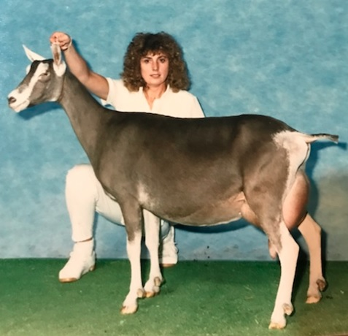
Started in 1972 with 2 unregistered goats
Next – 2 Toggs that went back to Stonybrook Cavalier and Stonybrook Sherman & those were the sires she used

Slide 3
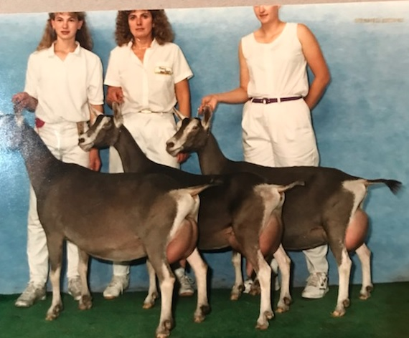

Slide 4
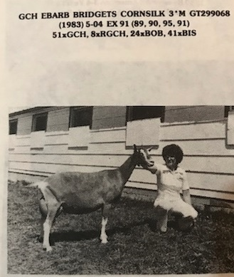
Cornsilk was a beautiful recorded grade doe sired by Stonybrook Sherman that Barb loved to show. Paul Kemp, a judge at the time, always joked, “Why didn’t you leave that damn goat at home…because he know she would always win”

Slide 5
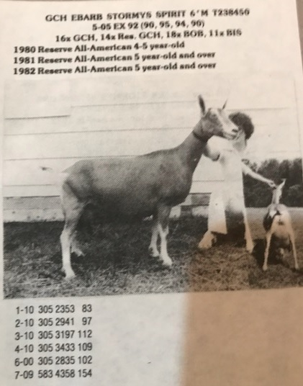

Slide 6
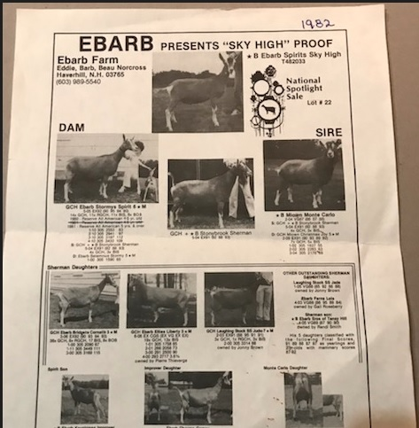

Slide 7
Membership in ADGA since 1972
On Milk Test from the ‘70’s until 2021 - Many Toggs Milked over 3000#
Did Linear Appraisal starting with the Classification Program in the early 80’s
Attended 3 National Shows plus the 2022 Show
A Licensed ADGA Judge since 1982
4 Spotlight Sale Animals – IL, TX, CO, NY

Slide 8
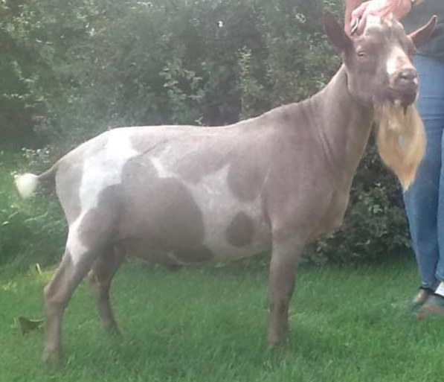

Slide 9
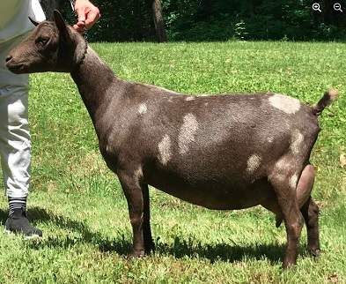

Slide 10
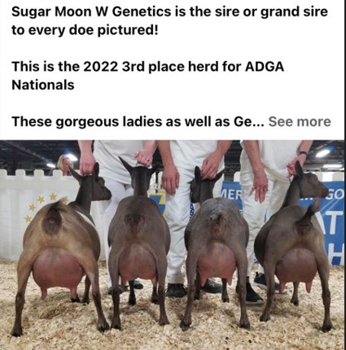

Slide 11
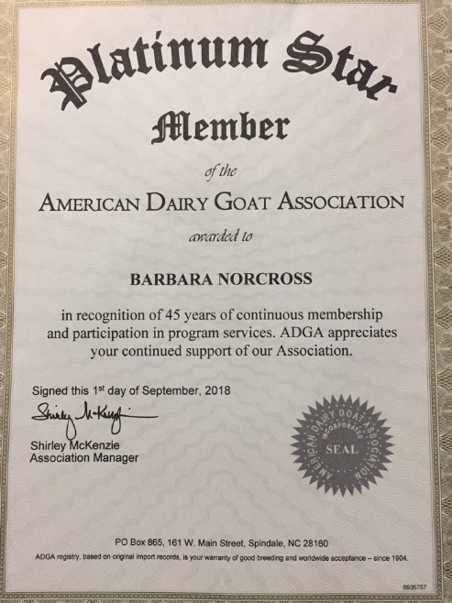

Slide 12
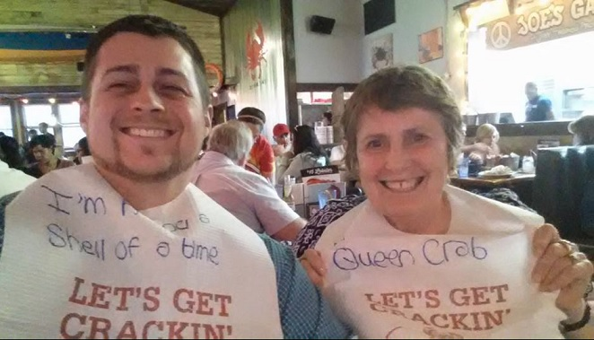
“I mentored Tommy Cox.”

Slide 13
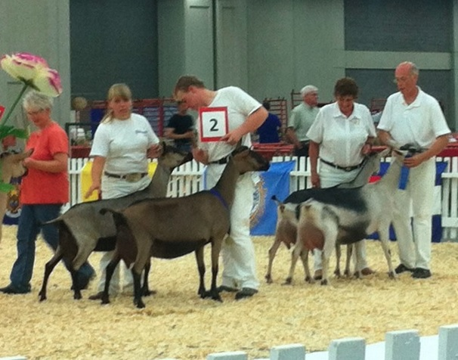

Slide 14
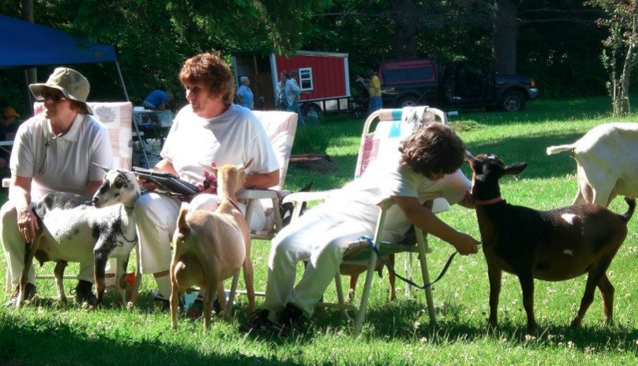

Slide 15
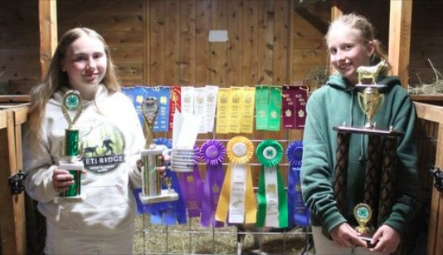

Slide 16
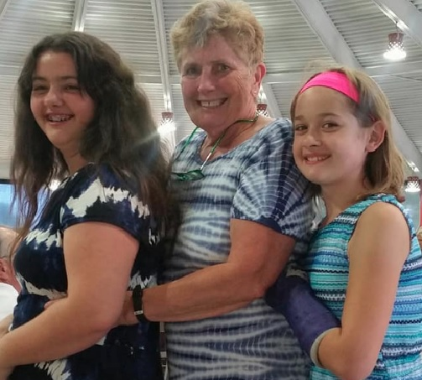
Barb says, “I will continue to work with the purchasers of my dairy goats, do fitting and showing workshops, and continue to encourage young people that are interested in goats and encourage them to join ADGA. I still love to look at good goats.”

Slide 17
“Doug Thompson said he always remembered me judging in my riding boots, a dress jacket and a tie. The story behind that was my father helping me tie my tie and telling me, “Even if you don’t know what you’re doing, at least you can look good.”

Slide 18
