Slide 1
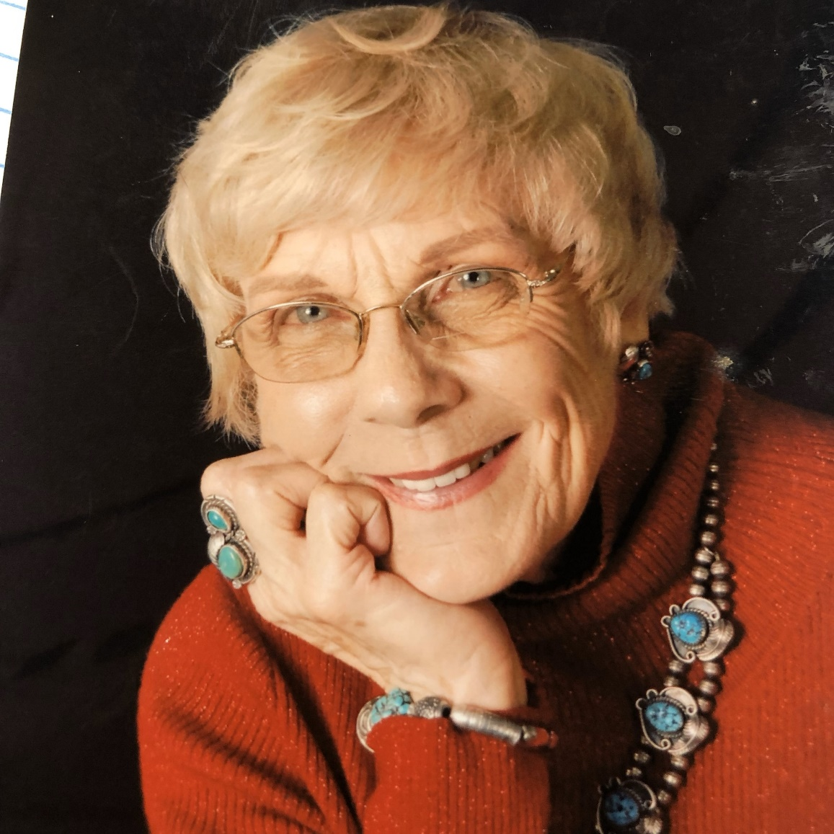
“Dairy goats have been so good to me to allow me to expand my world, my friendships and my experiences. Over the years, I have had an ideal of what I believe to be the right kind of animal.
I look at my goats now and see what an improvement there is, but how much more improvement can be made. I want to continue to have competitive animals in the show ring that are also hardy and productive animals at home.”
- Melinda Butler

Slide 2
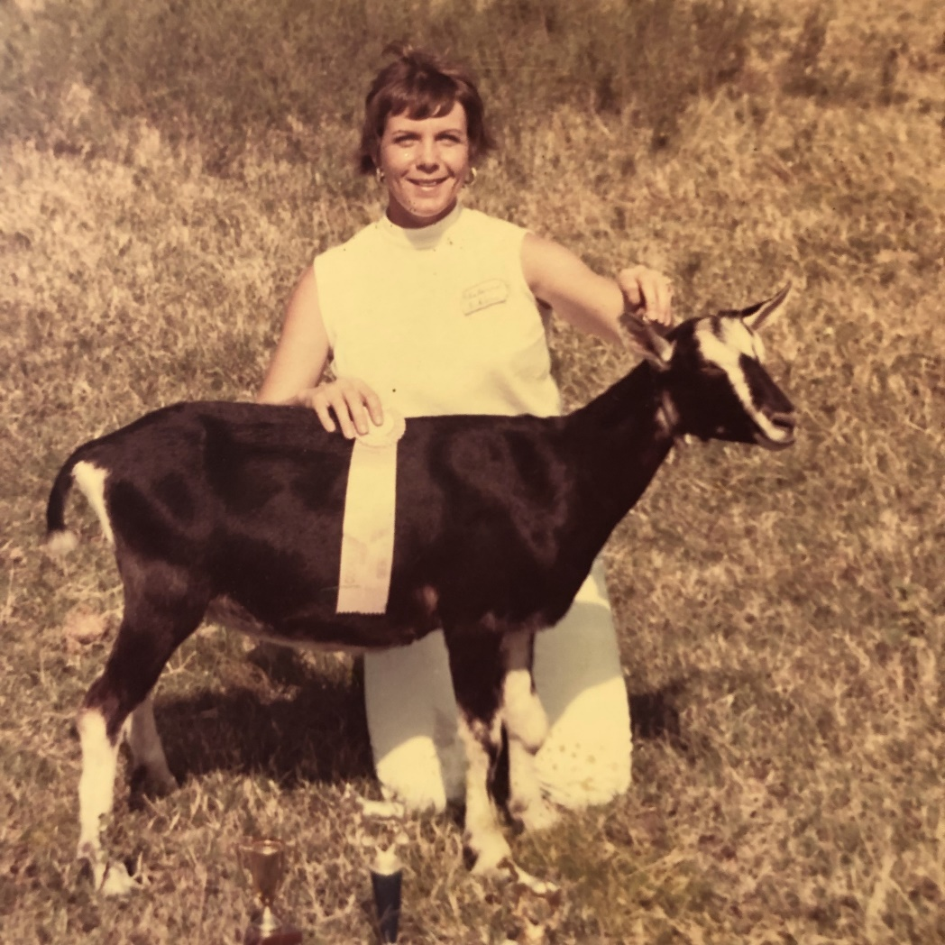
Alpines Were an Early Passion..

Slide 3
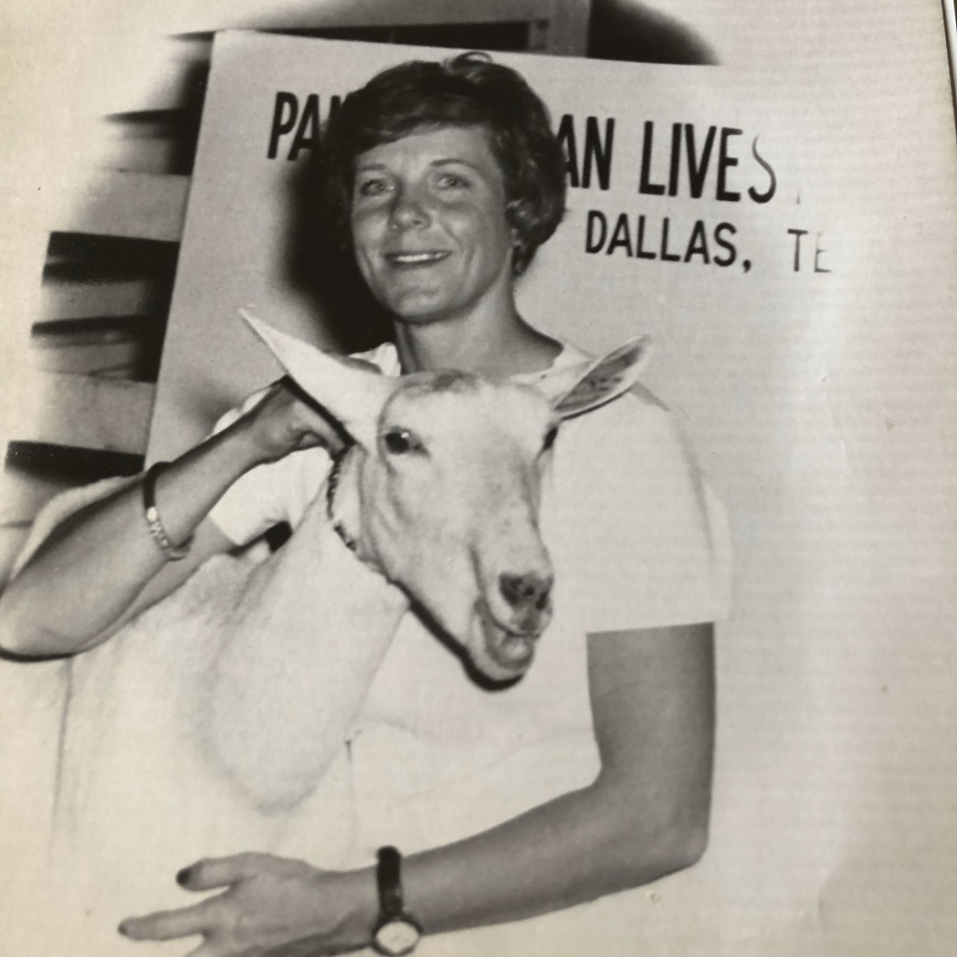
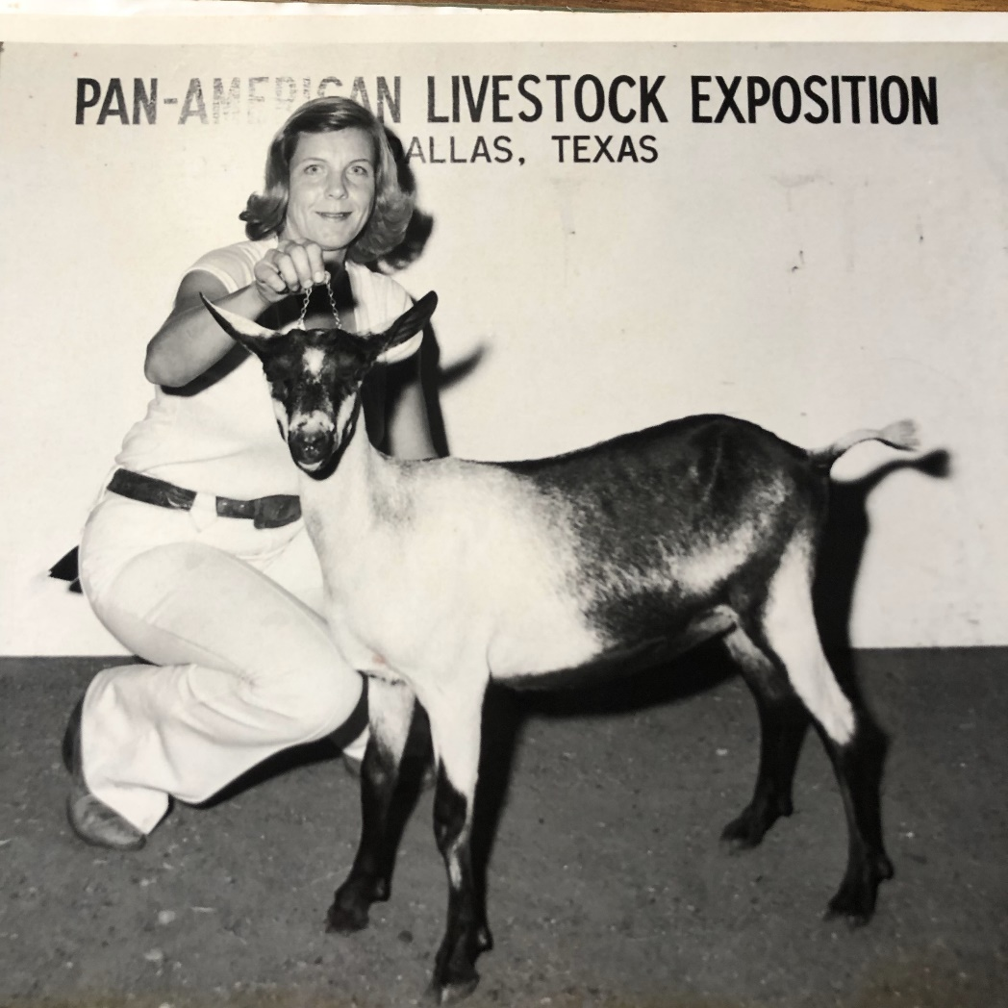
Showing at the Pan-American Exposition
Dallas, Texas

Slide 4
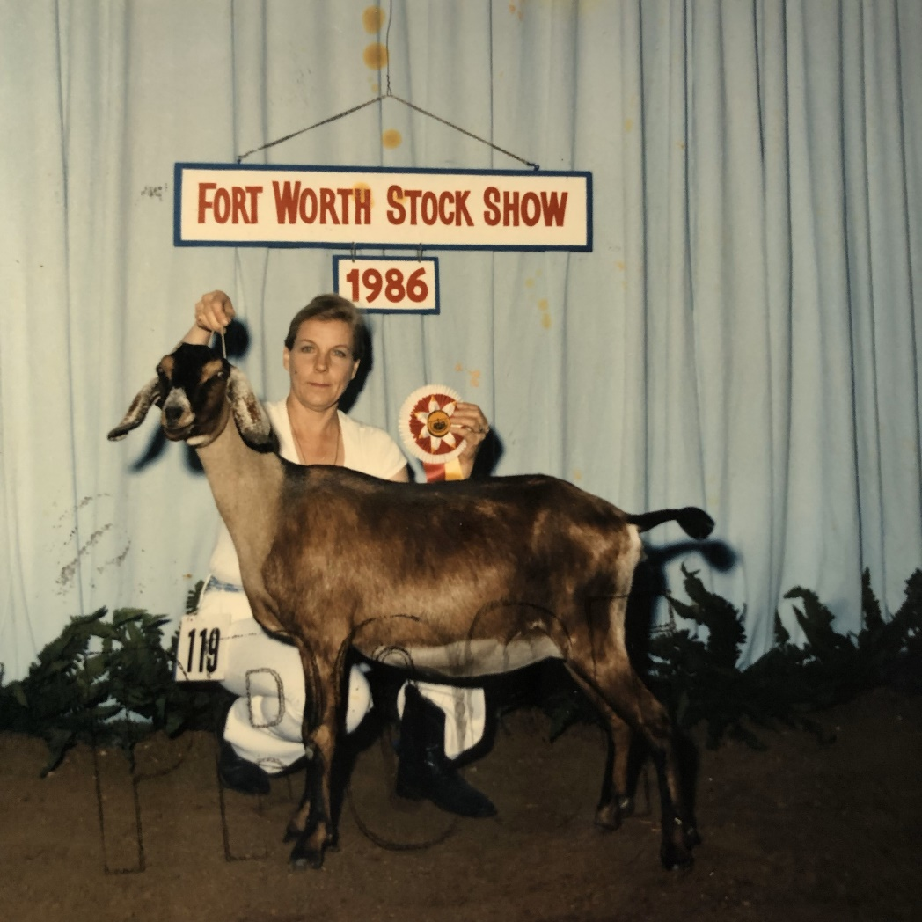

Slide 5
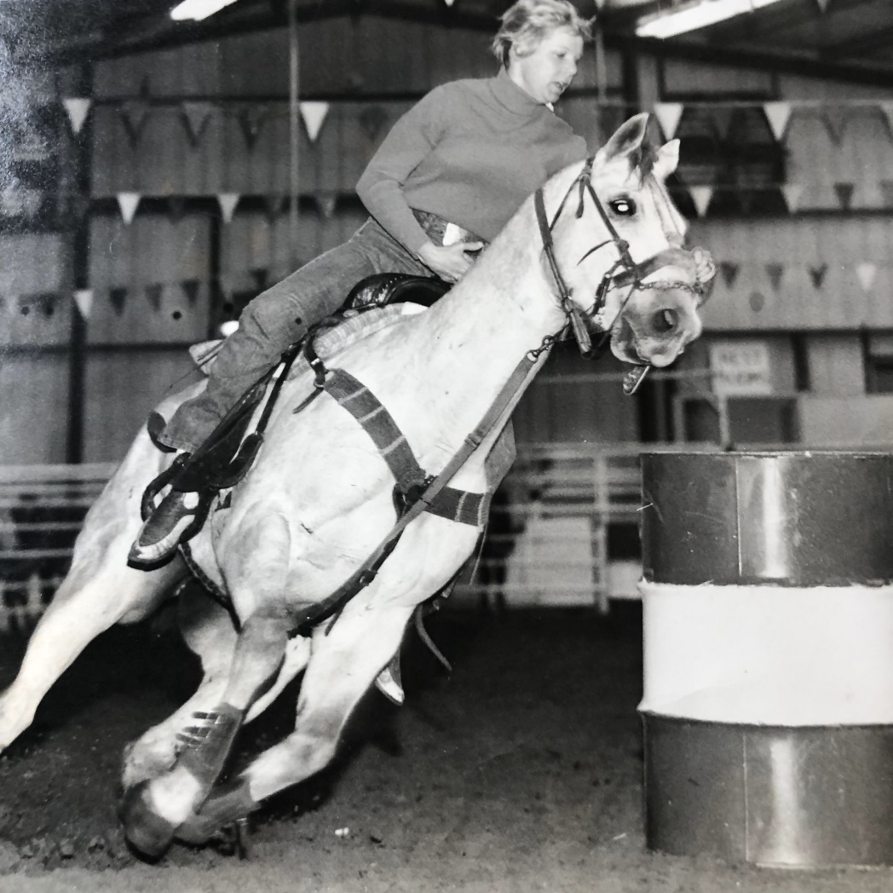
Melinda’s Parallel Life:
A Champion Barrel Racer!

Slide 6
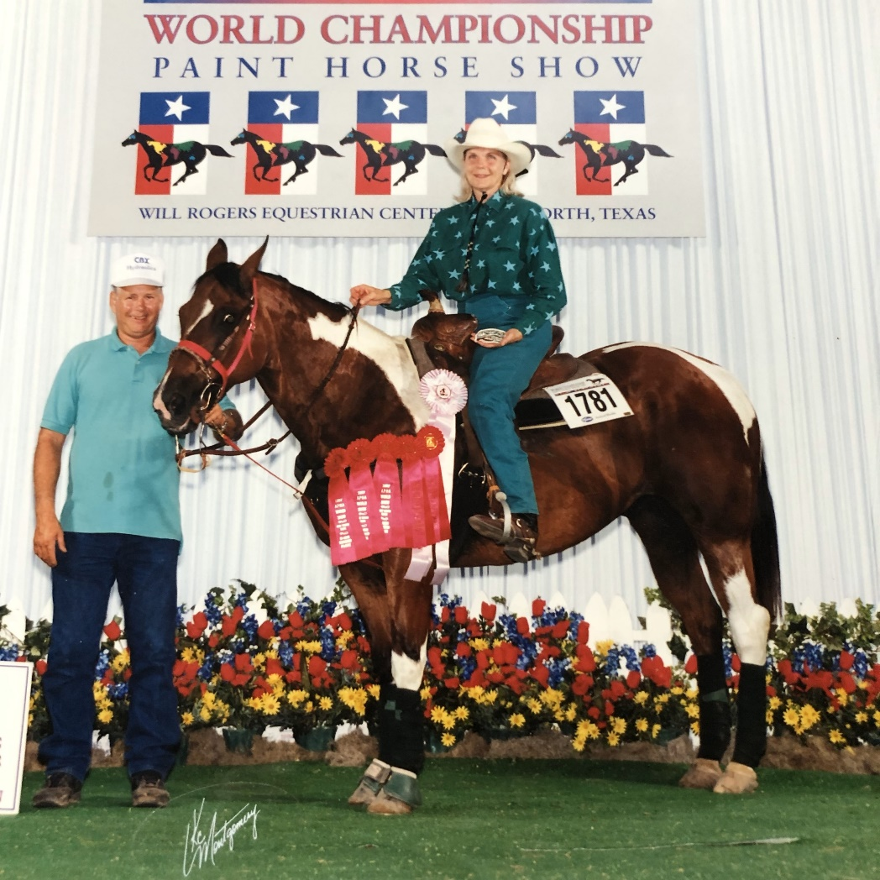
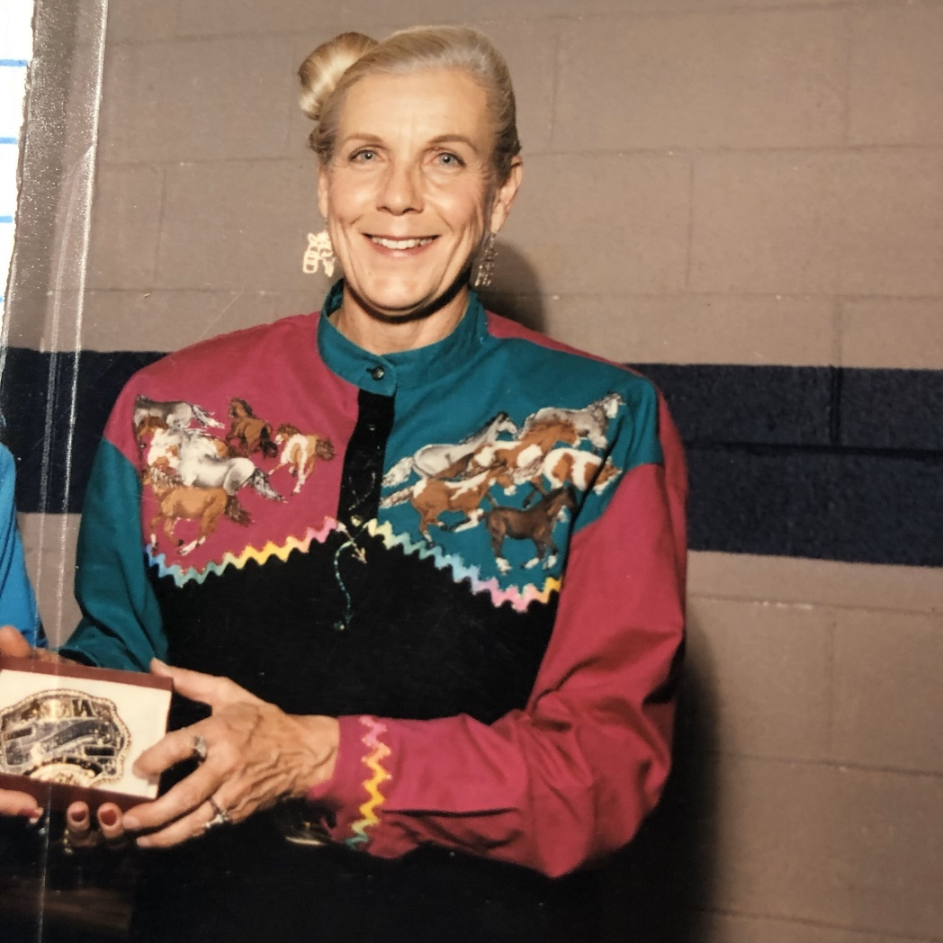
And Paint Horses!

Slide 7
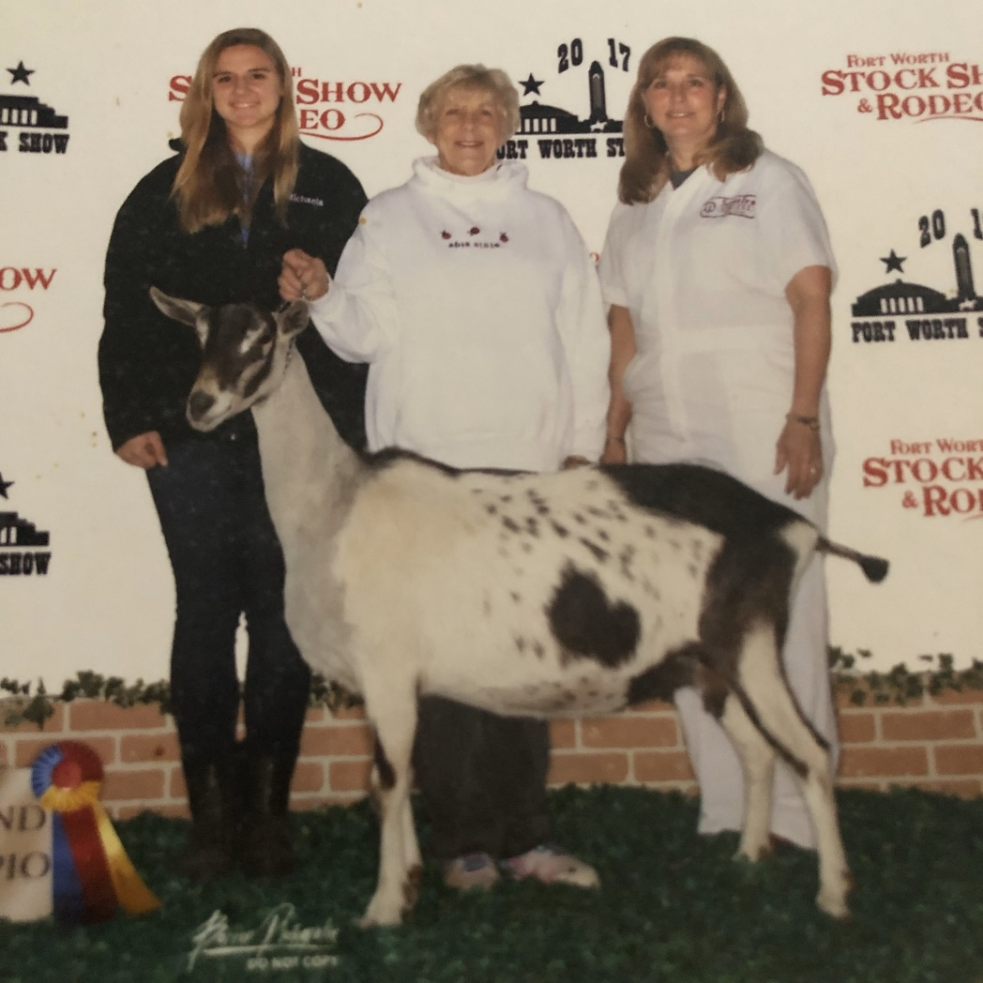
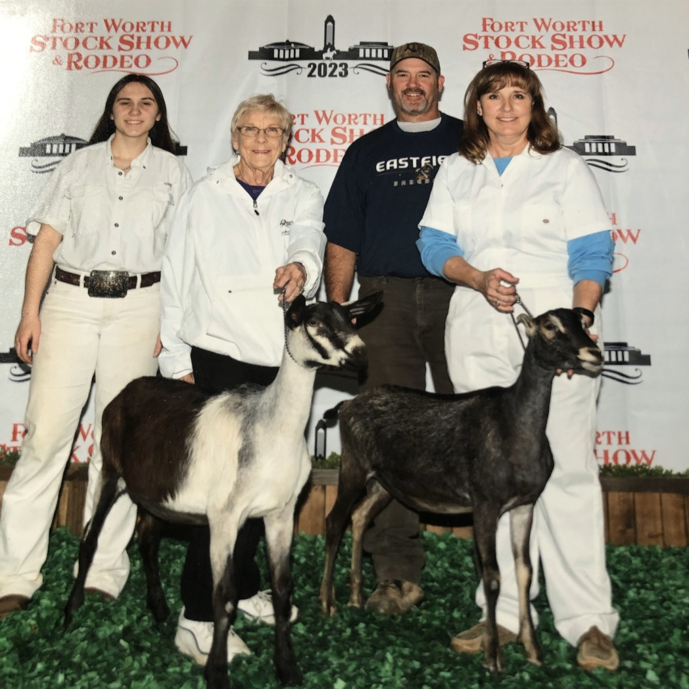
Mentoring the Next Generation in Dairy Goats

Slide 8
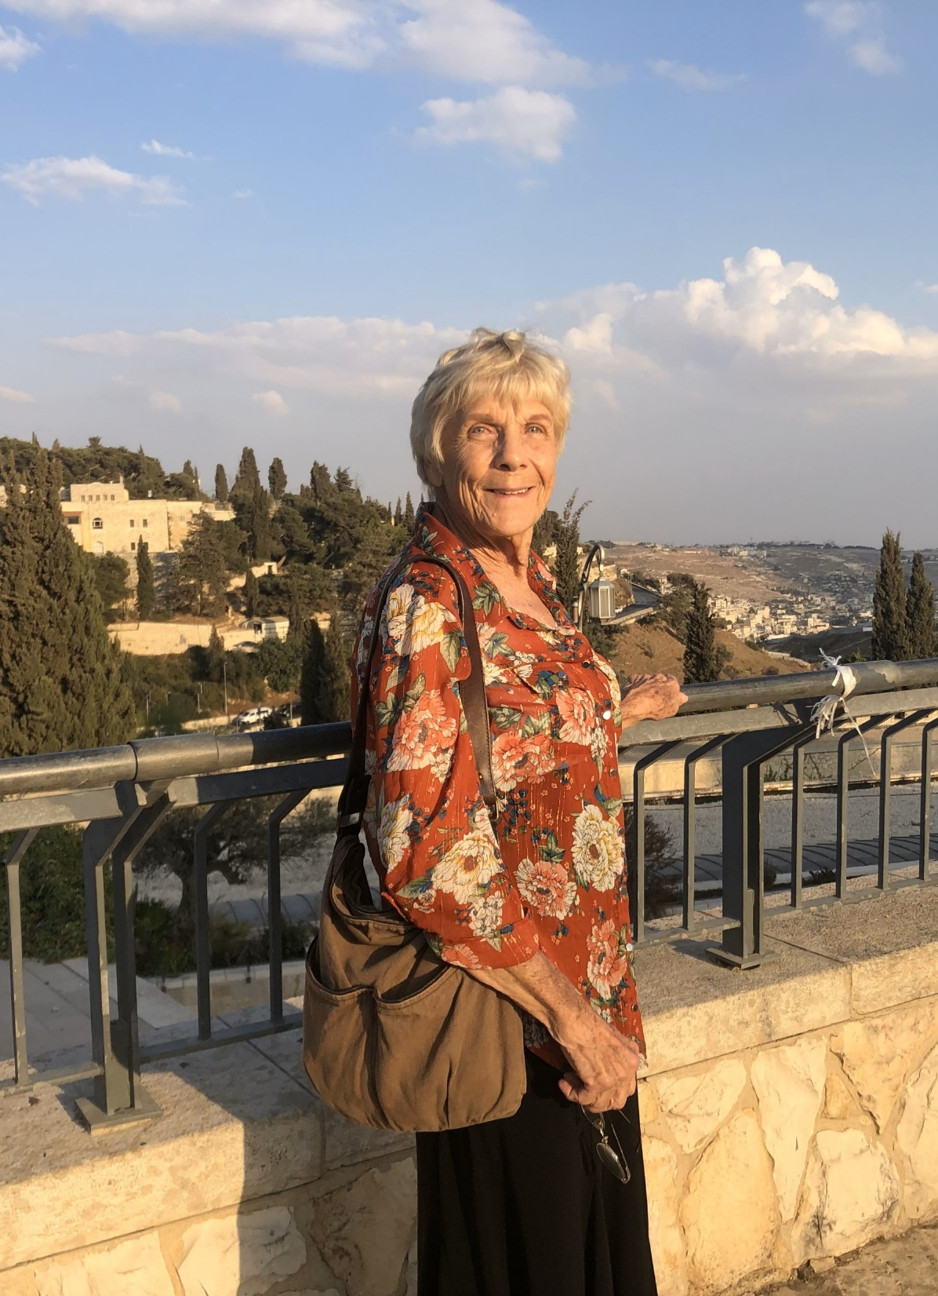
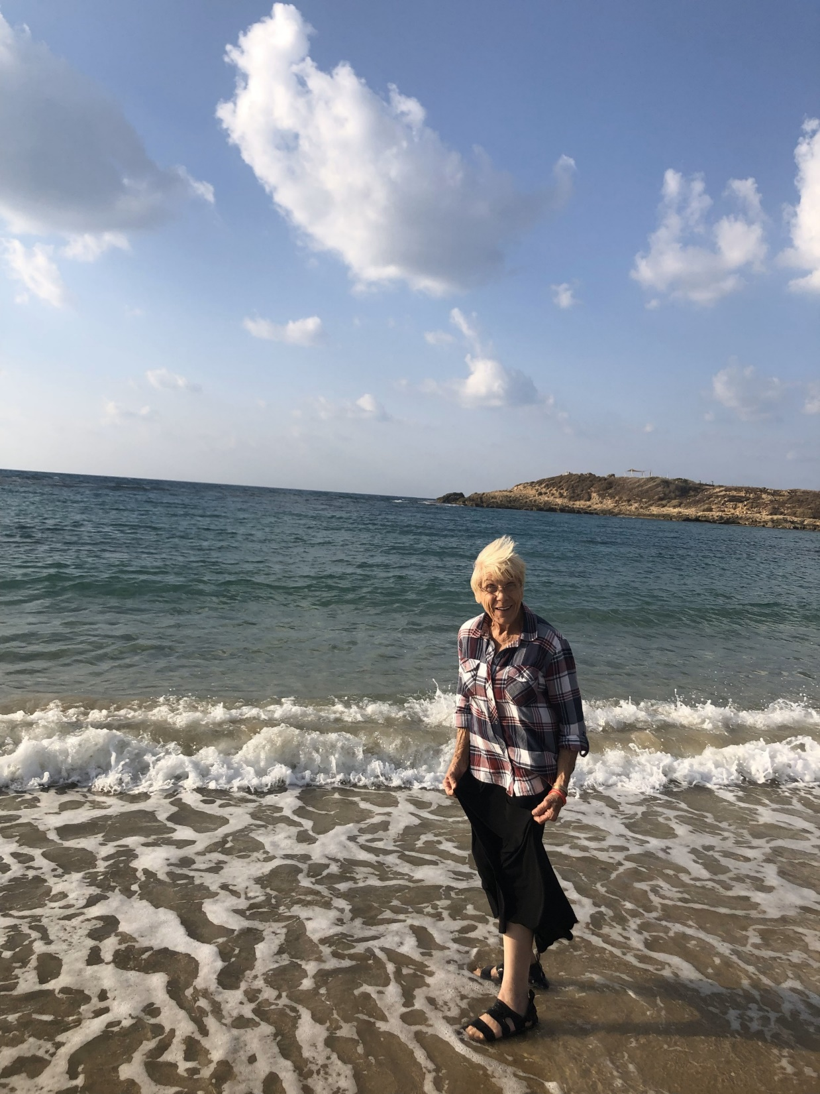
Traveling to Israel

Slide 9
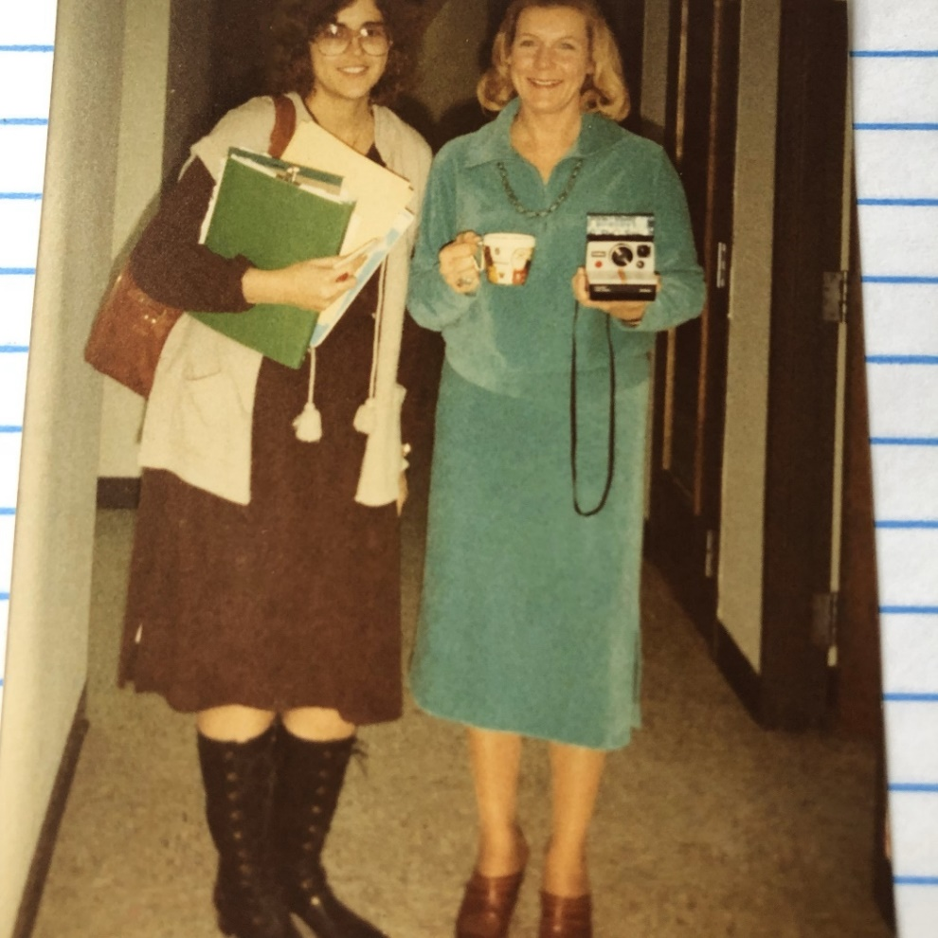
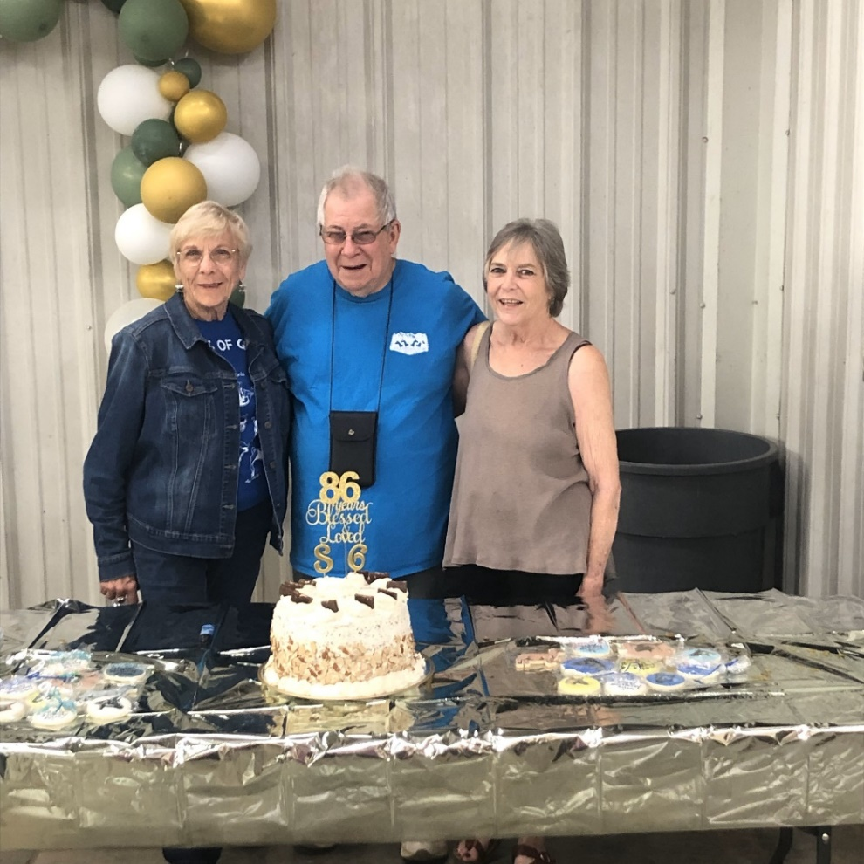
With Fellow Goat Friends:
Past & Present

