Slide 1
Huelette Allen Cunningham

Slide 2
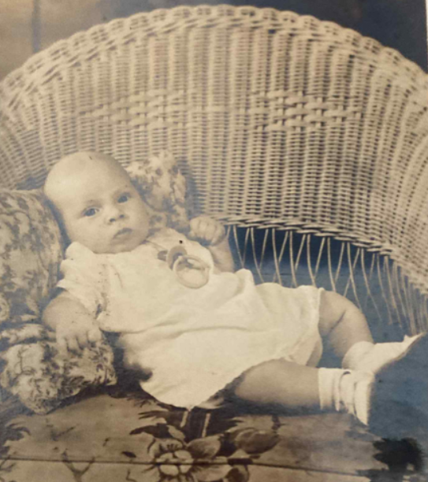
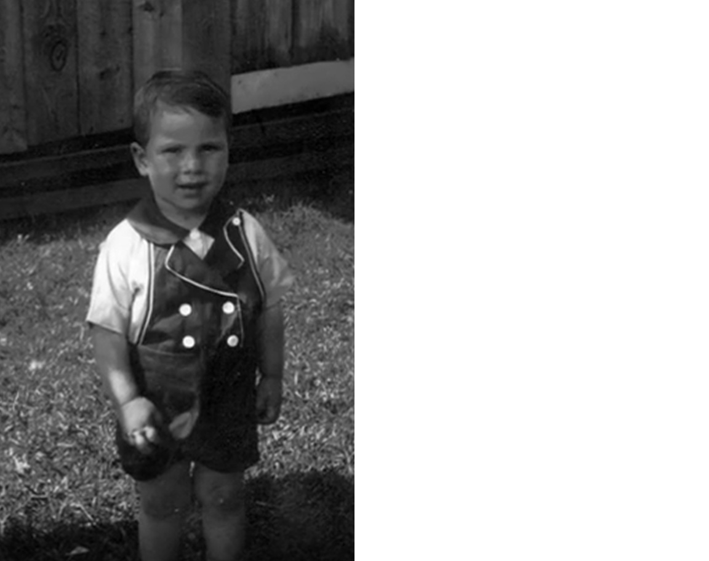
Starting Young

Slide 3
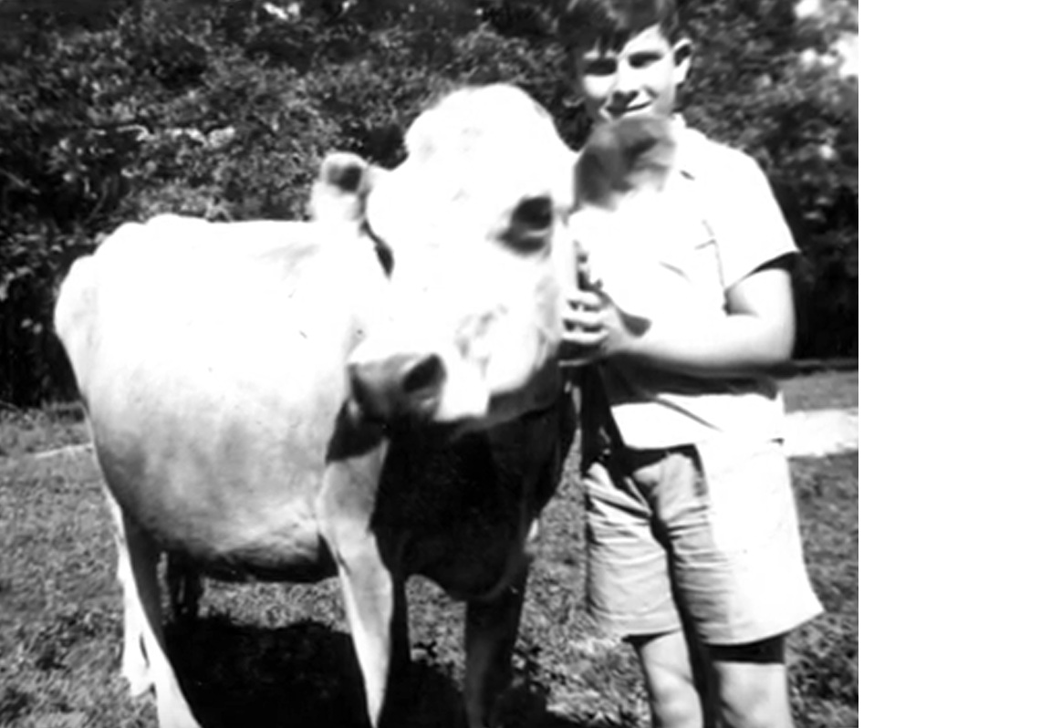
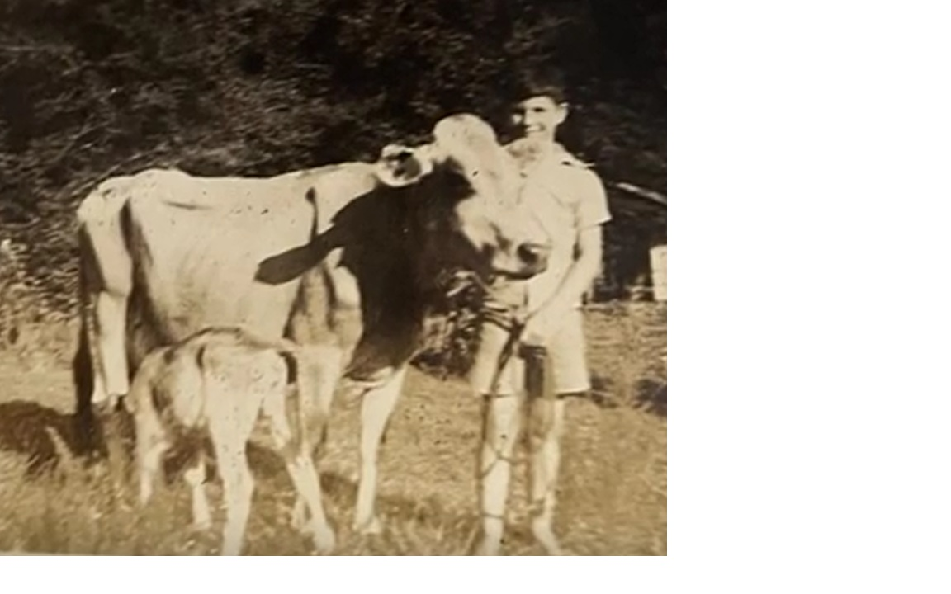
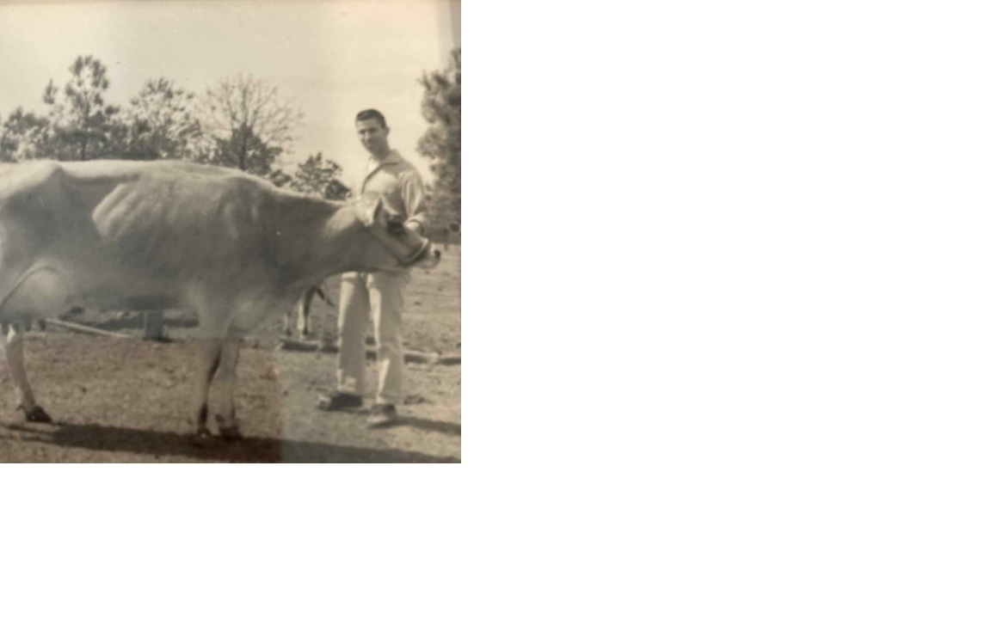
Early Beginnings in Livestock, which never ended

Slide 4
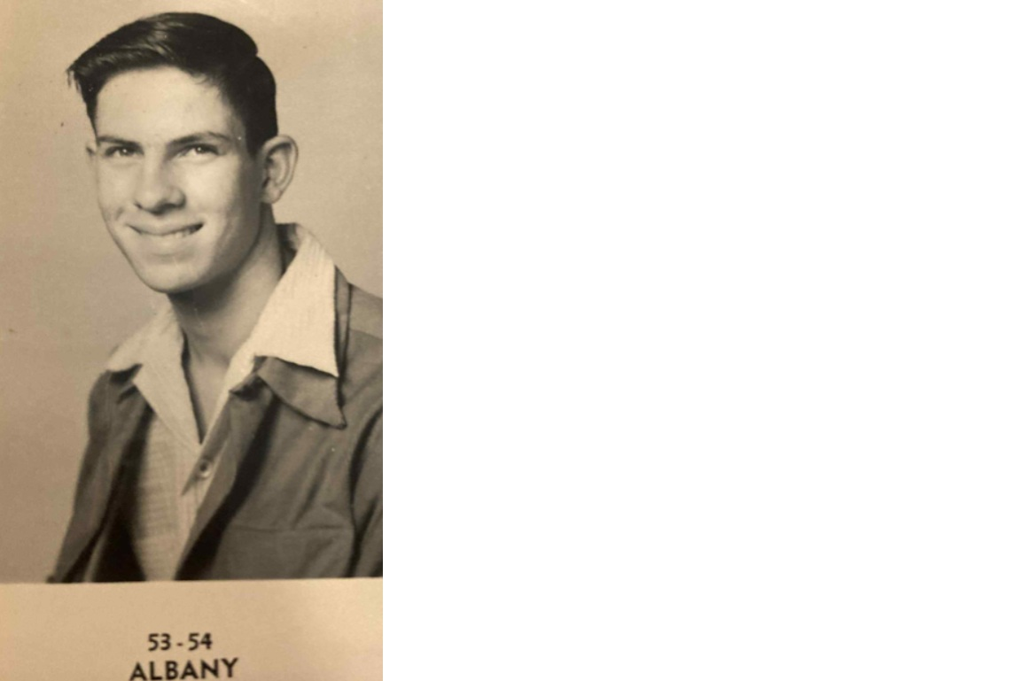
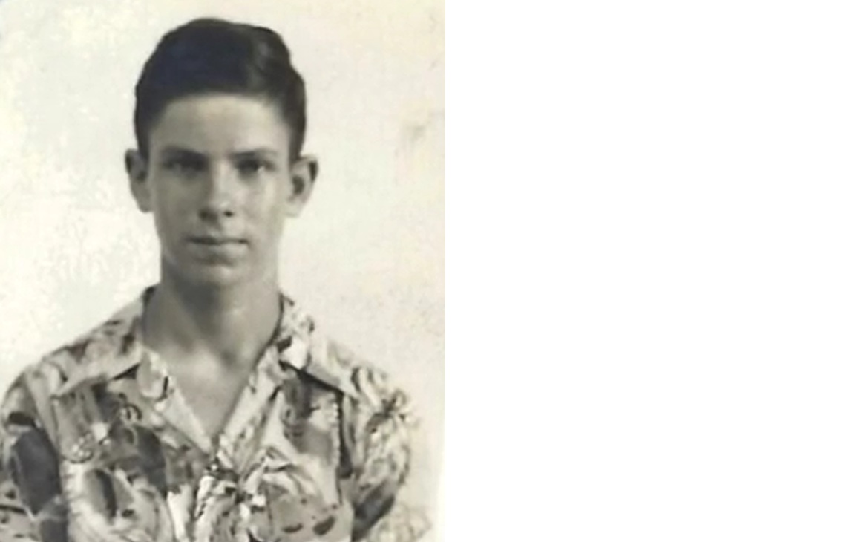
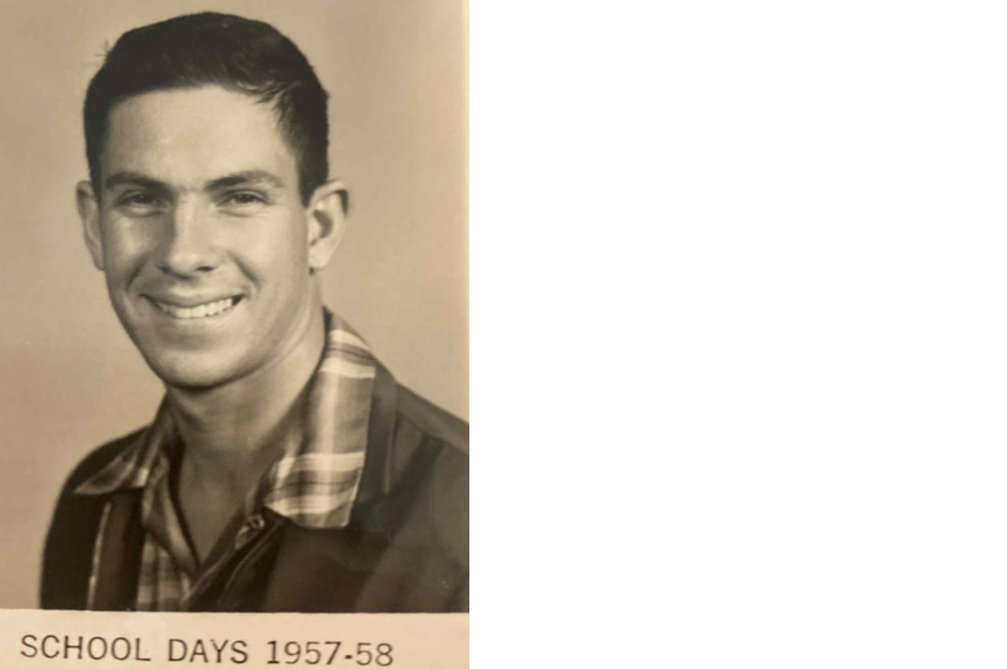
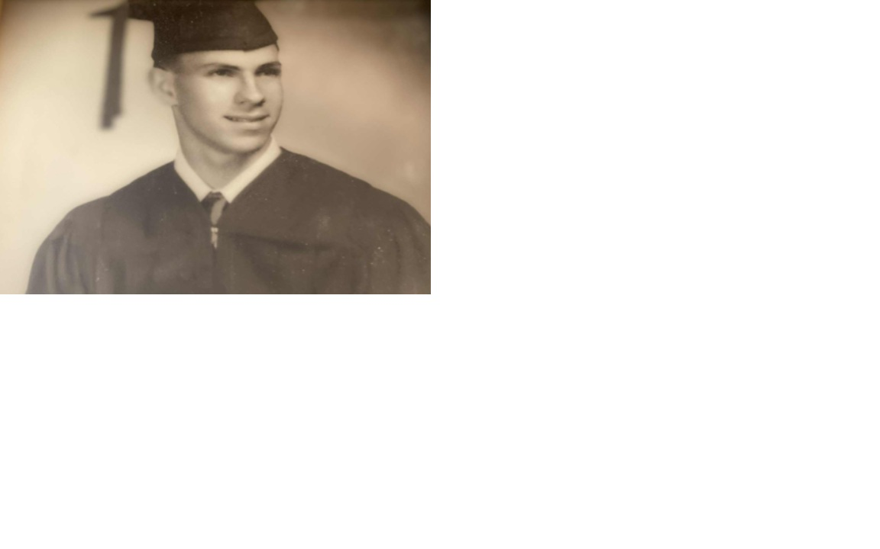
A rake and a rambling young man

Slide 5
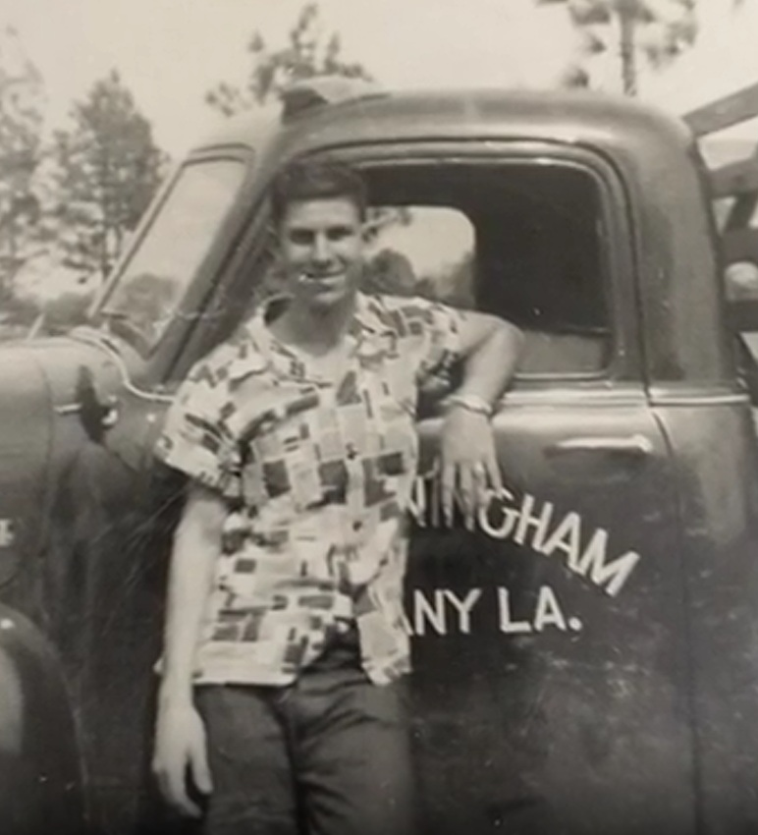
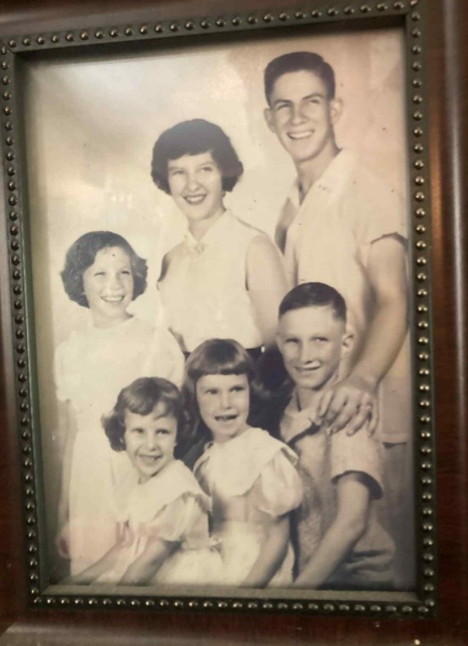
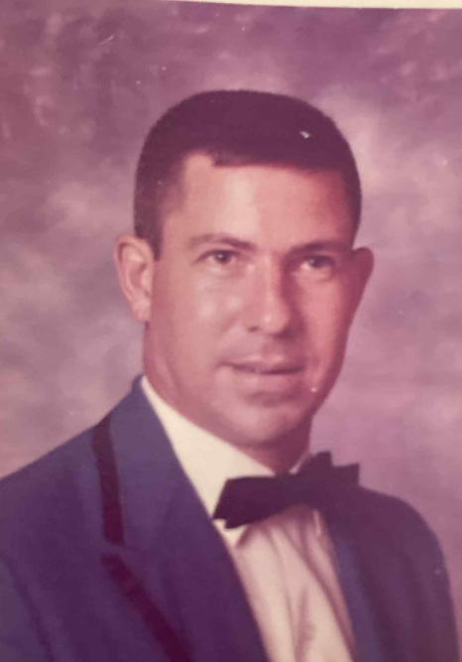
Allen with his Little Brother and Four Sisters
A casual young man
leaning against his dad’s
strawberry truck.

Slide 6
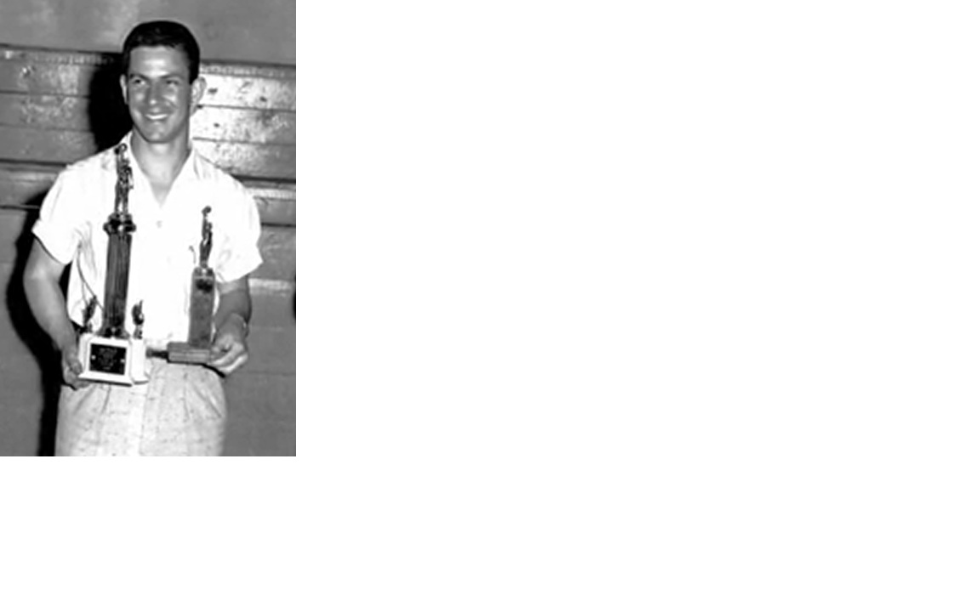
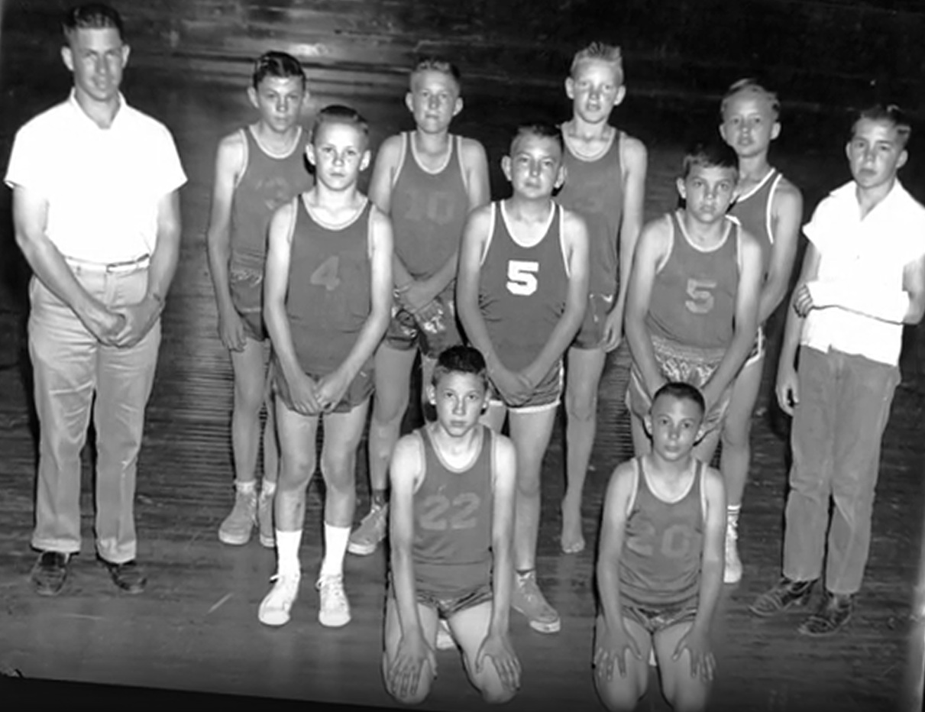
As a Young Teacher and Winning Coach
Allen was a winning basketball coach, however having never played team basketball himself.

Slide 7
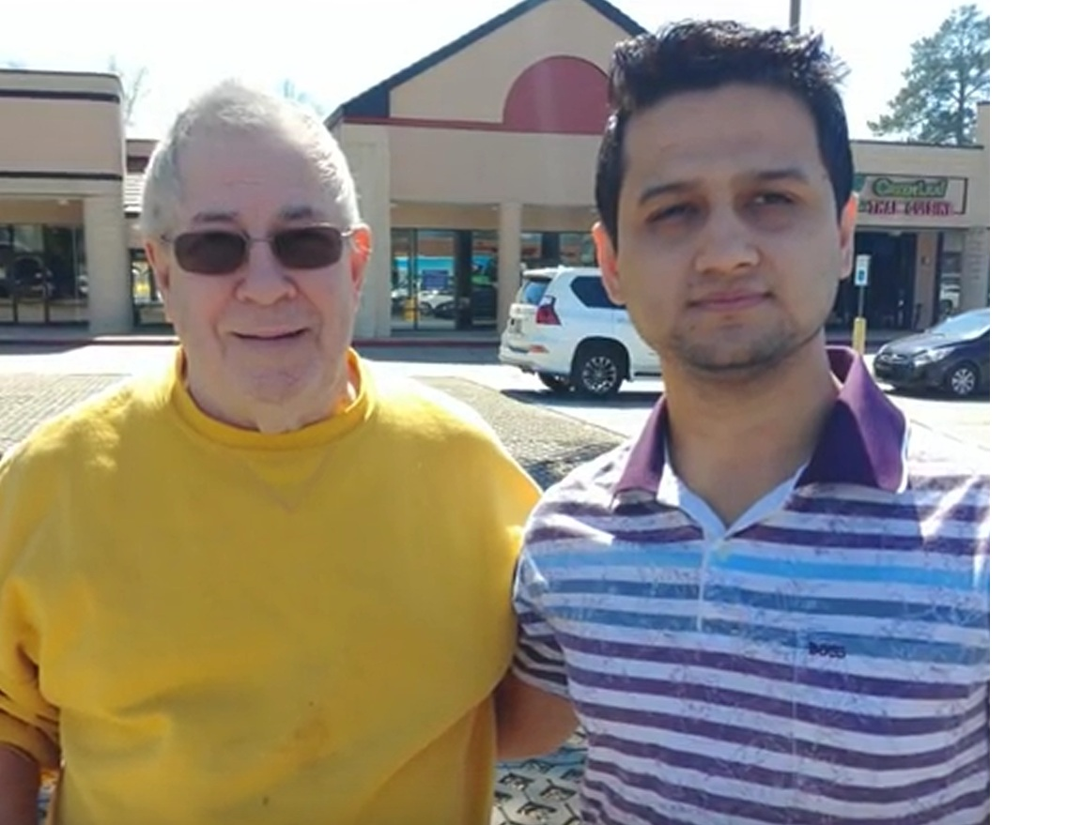
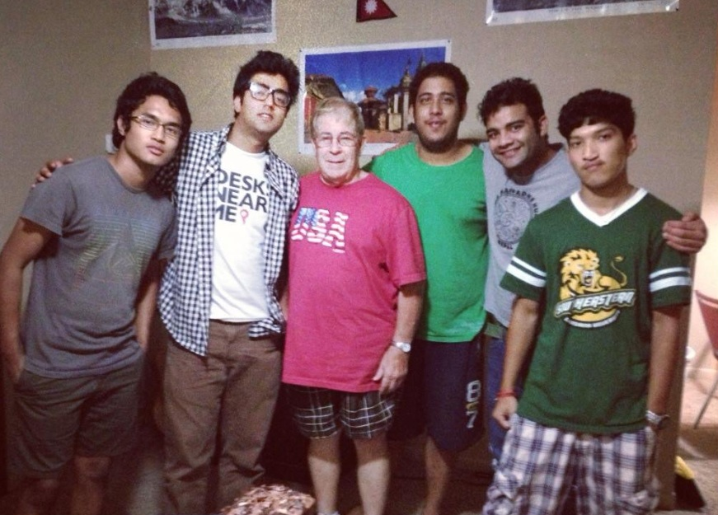
From His Days at Southeastern Louisiana University with Students from Nepal

Slide 8

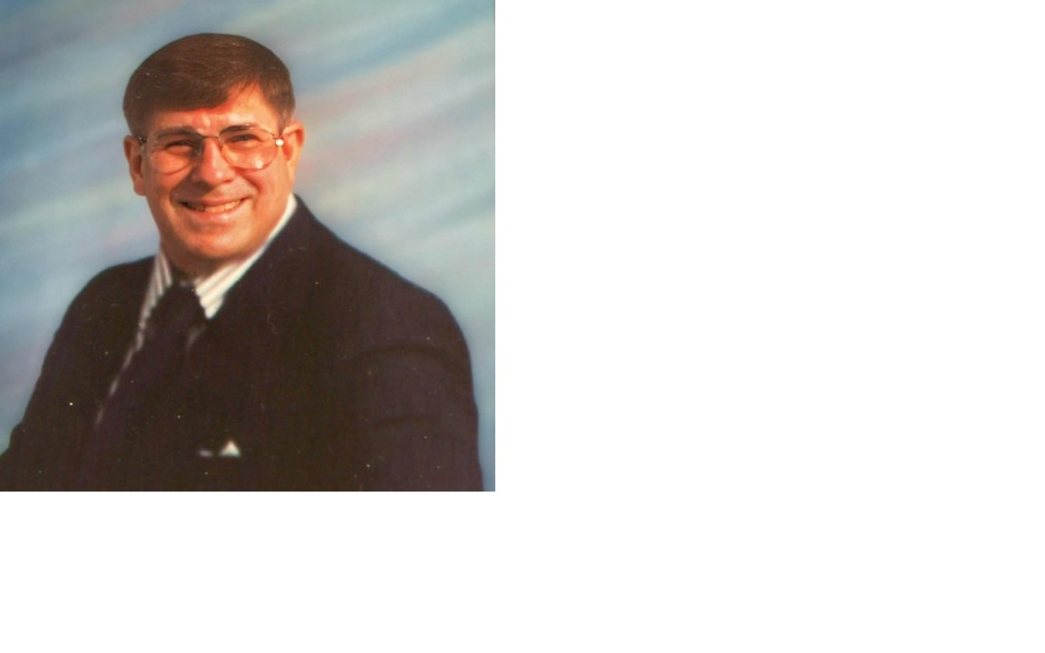
After 20 Years as a Teacher, 31 Years as a Librarian

Slide 9
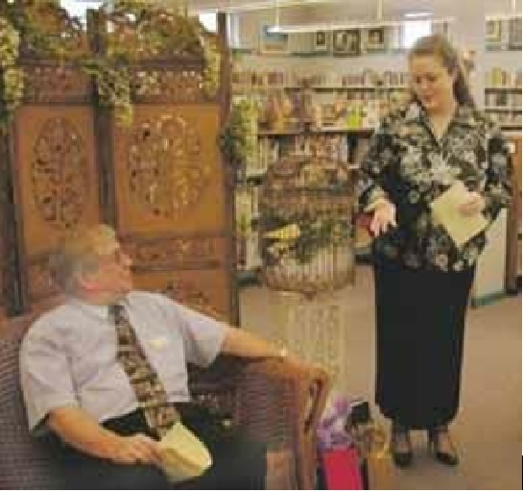
His Retirement after 19 Years as Director of the Livingston Parish Library System
“Cunningham presided over the transformation of the system from a ragtag group of tiny branches into the five state-of-the-art regional library branches that opened this year, a goal that kept the septuagenarian working long past the usual retirement age.”

Slide 10
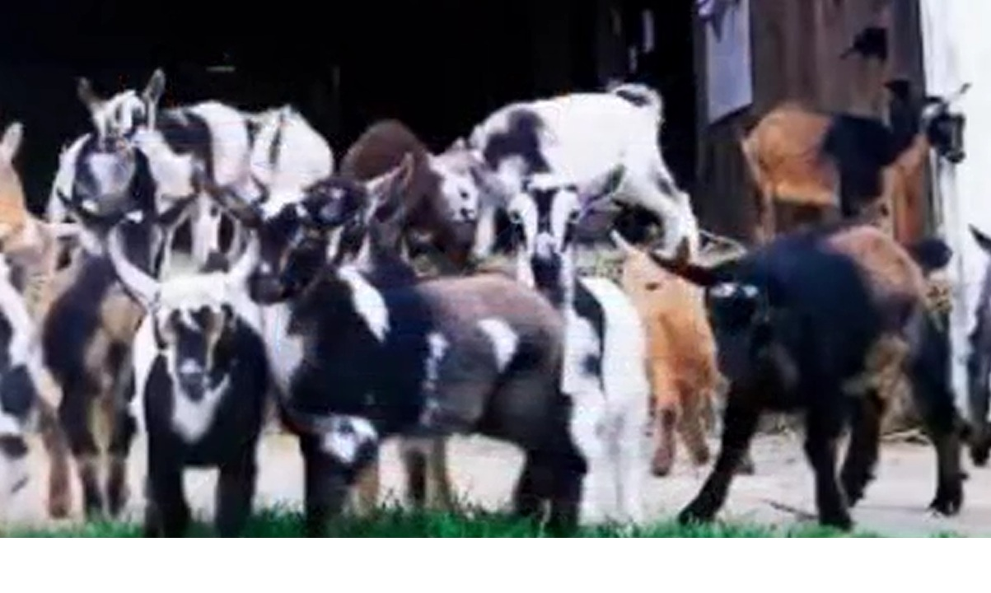
And then there were goats

Slide 11
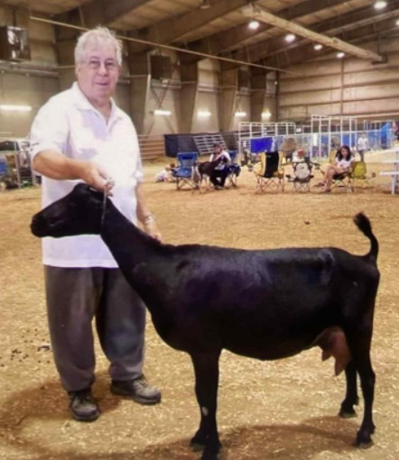
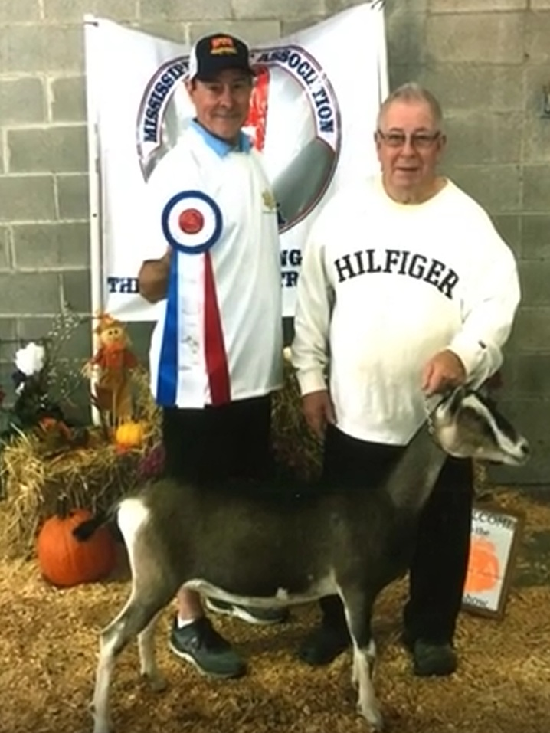
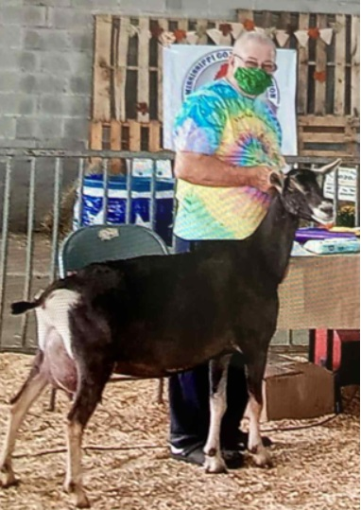
As an Owner, Breeder, Supporter & Director
Allen was very active in goat associations across the South.

Slide 12
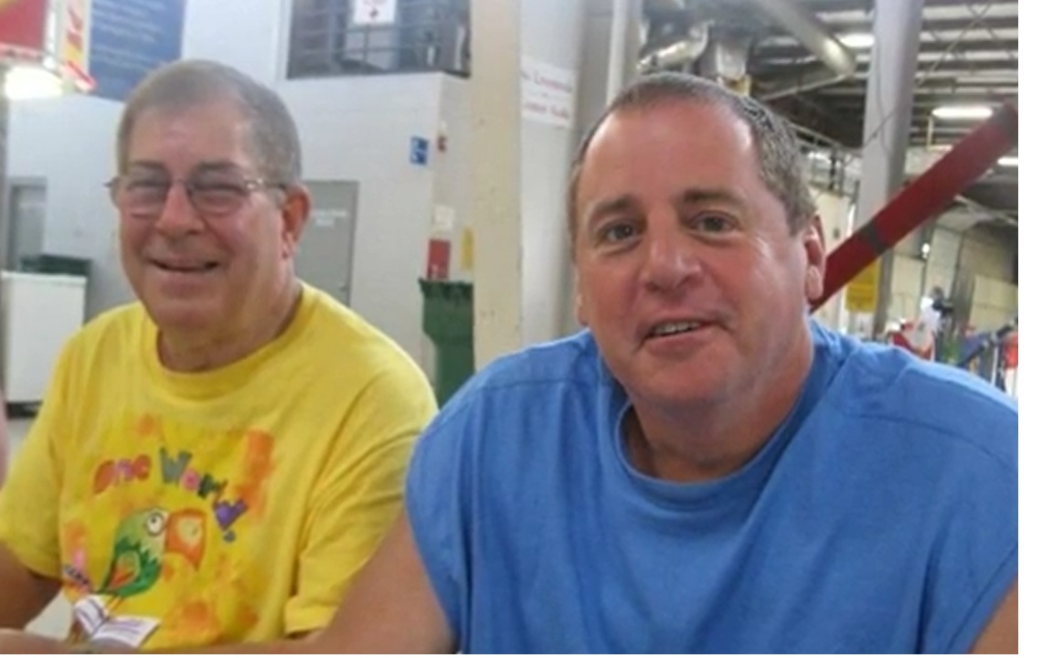
With his Long-time Partner Chuck Cruce

Slide 13
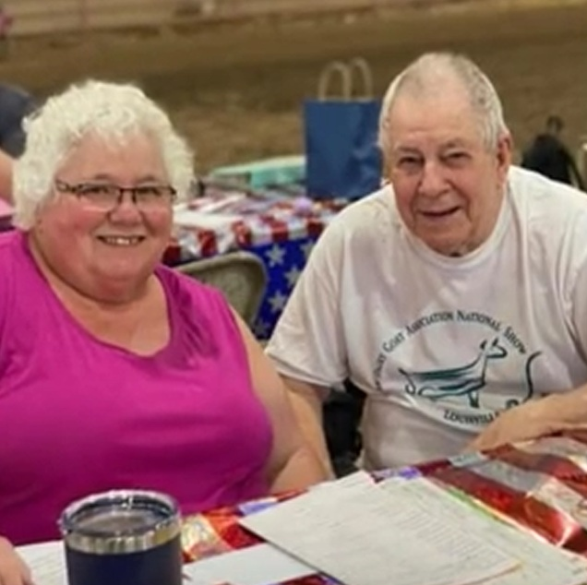
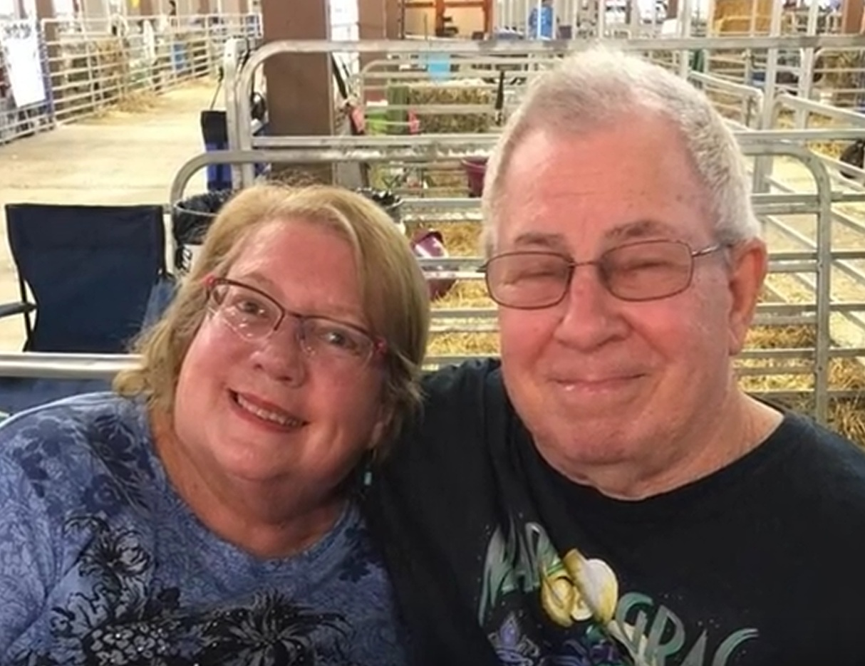
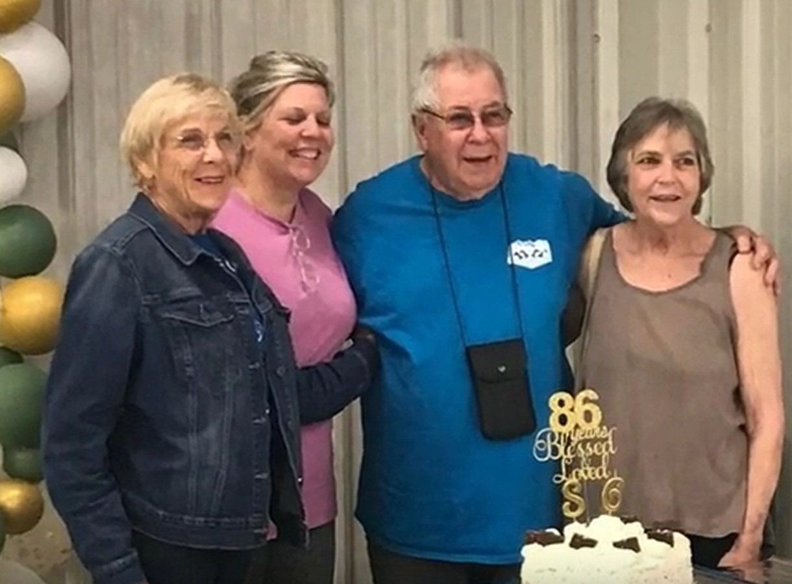
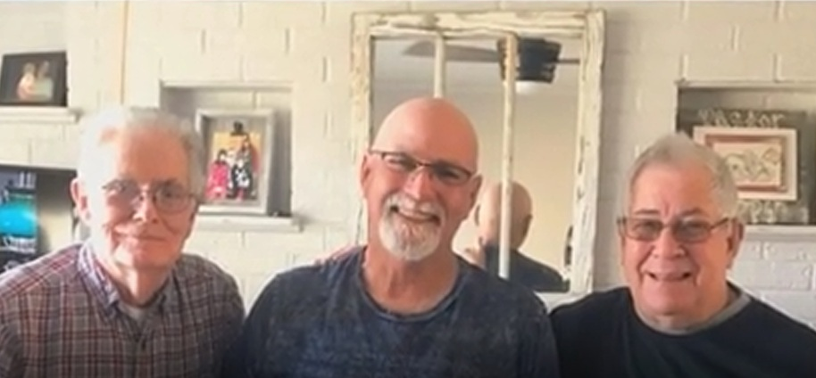
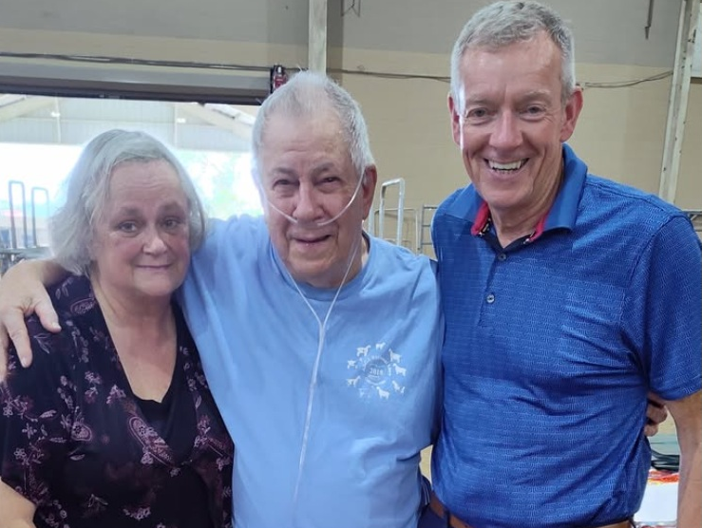
Including Many Friendships in the Goat World

Slide 14
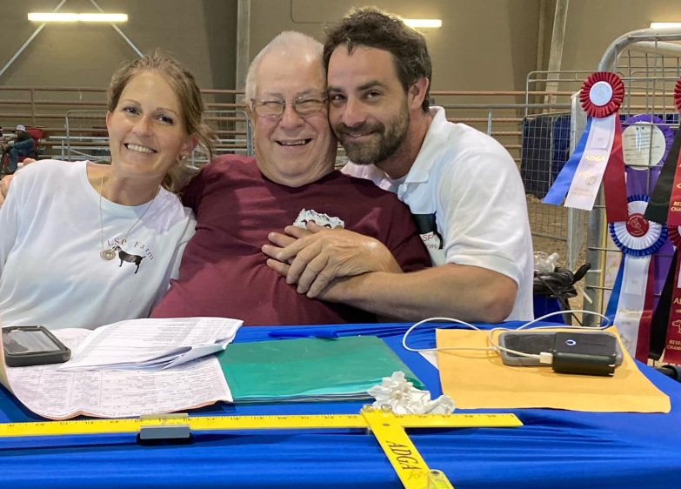
The most often used words to describe Allen were “kind, gentle, compassionate, quiet, easy mannered, knowledgeable.”
Long-time ADGA Member
ADGA Judge
USBGA Judge
ADGA Director
ADGA President (~2005)

Slide 15
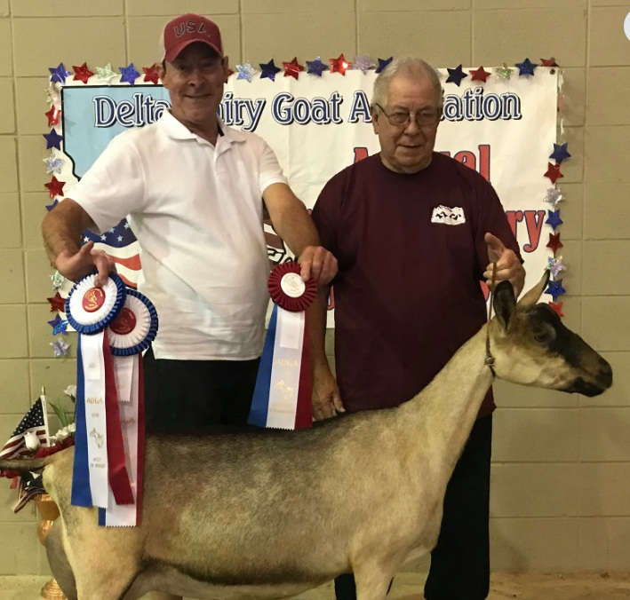
Allen with his Nephew, Cory Cleveland

Slide 16
Cory tells this story…
After Nationals in Oregon, he was trapped because of a hurricane in New Orleans. I said, visit some goat farms, but he said no because he would buy a goat.
Ten days after he got home, he met me after work and said we had to go to Memphis… for goats.
I asked why he didn’t tell me sooner, and he said he didn’t want me to say, “I told you so!”
I was so happy that he was excited about them. I just wanted to help keep his dream alive.
Notes:
“The last time he went to Nationals in Oregon, he was trapped there because the New Orleans airport was closed for a hurricane. I told him to go visit some goat farms, but he said no because he would buy a goat. I told him to go for it and if he found one, to get her. He refused. He came home in a few days but was vague about his time there. Ten days later he met me at my door after work and said we had to go to Memphis to pick up some goats. I asked why he didn’t tell me sooner, and he said he didn’t want me to say, “I told you so.” I was so happy that he was excited about them. He had shut down before I came to live with him, and I just wanted to help keep his dream alive. This is one of the does.

Slide 17
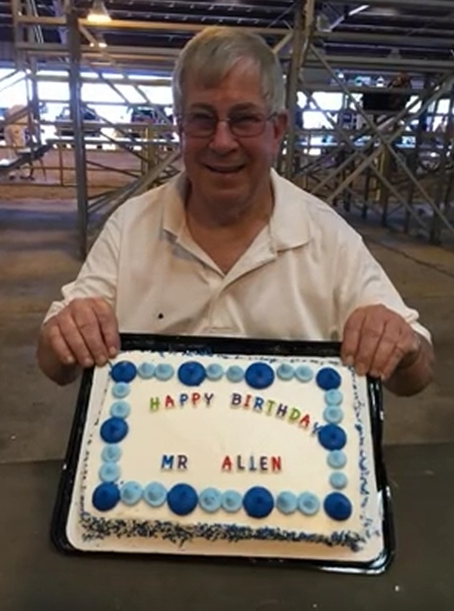
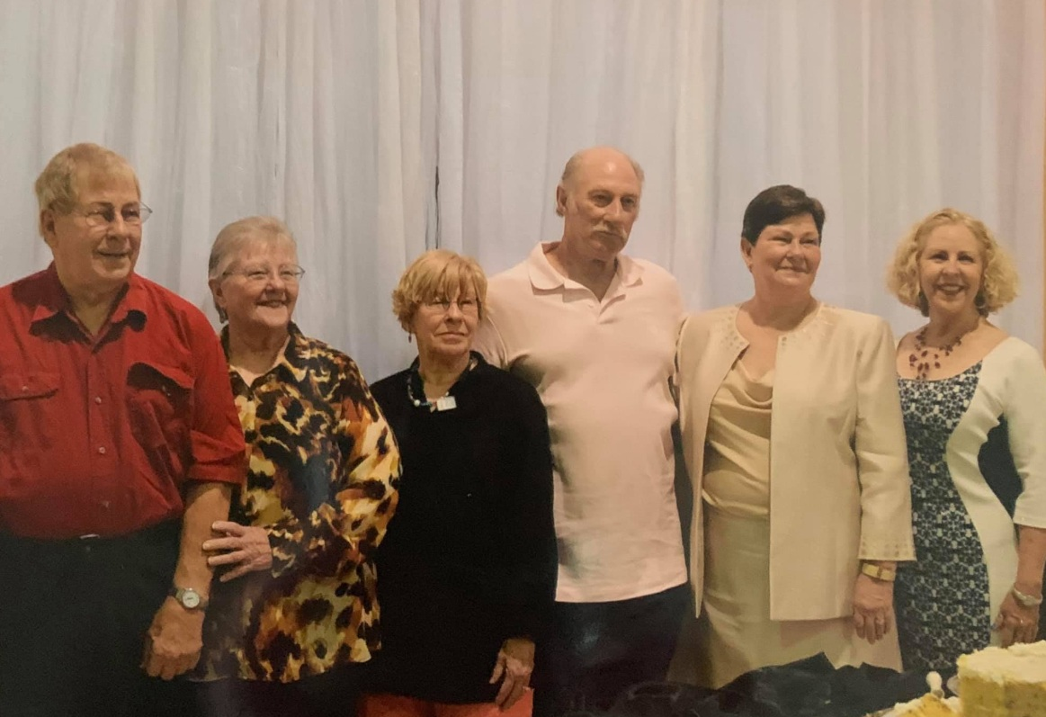
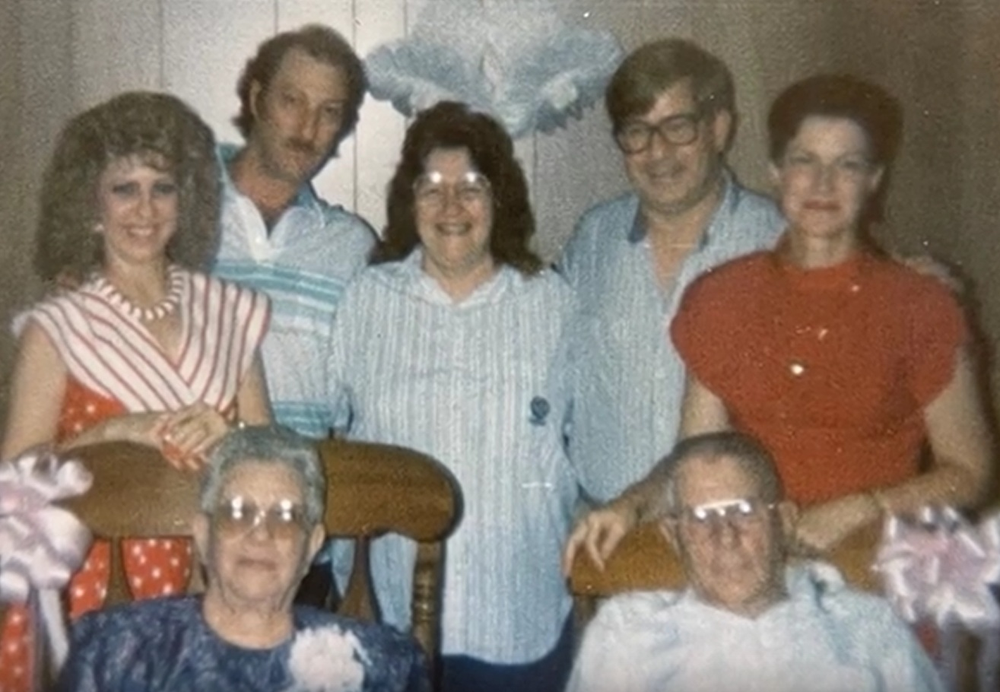
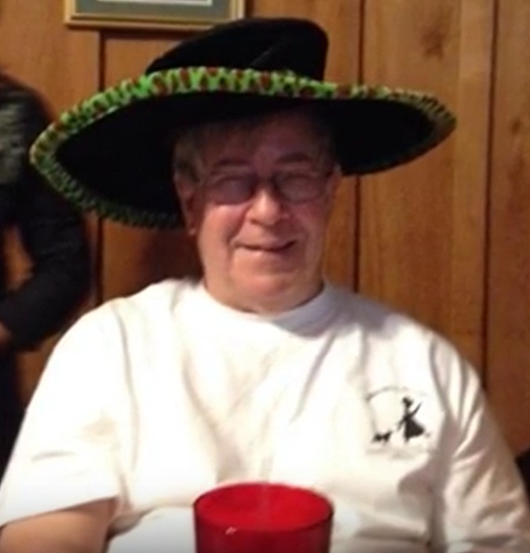
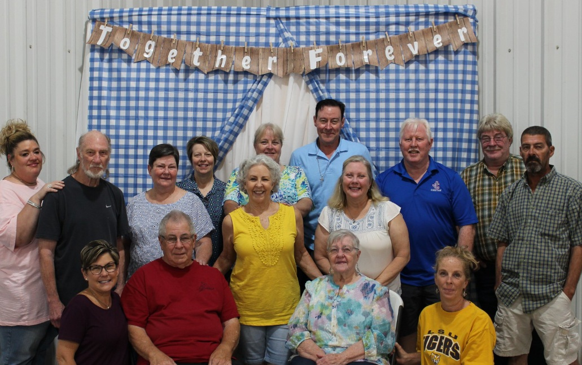
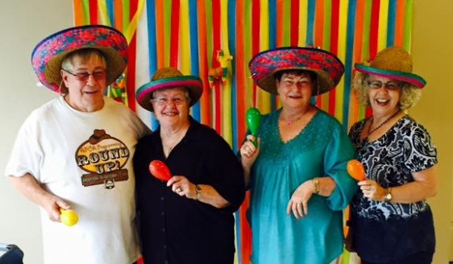
…For Allen, It Was So Often About Family & Friends

Slide 18
“Mr. Allen’s” Obituary
Born 1936, Died 2024 - Age 88
Lifelong resident of Albany, Louisiana
Occupation – Teacher & Librarian, Member Louisiana Library Association
Had an operational dairy
Raised, showed, and judged goats for ADGA and USBGA
Director and President of ADGA
Nigerian Dwarf Goats recognized as an ADGA breed during his Presidency
“A good-hearted, generous man, loving son, brother, uncle and friend .”

Slide 19
