Slide 1
Karyl Dronen
Two Breed Pioneer & Products Champion

Slide 2
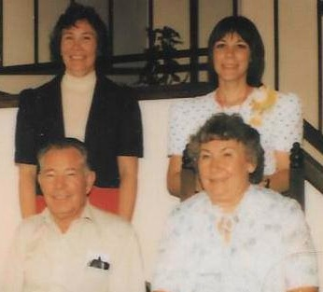
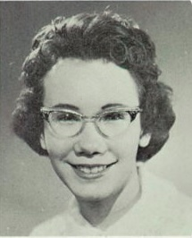
Early Years
Born a Farmer (Karyl Farmer) & Raised around Denver, CO
Karyl’s Father Operated “Farmers Greenhouse”
4-H, Future Farmers
ADGA Junior Member
Joined the Navy!
Further Education - as a Dietician / Nutritionist

Slide 3
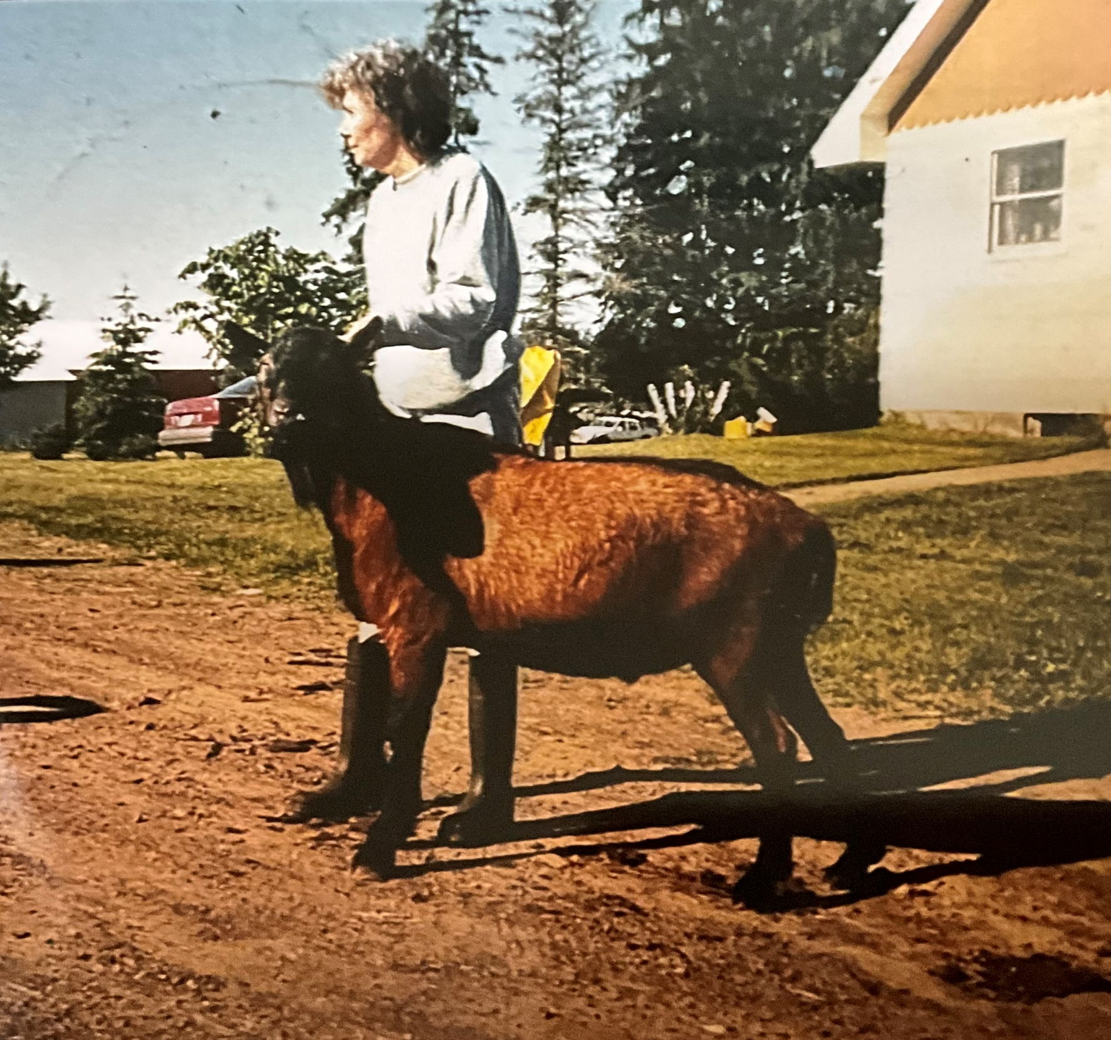
Beginning Goat Years
Married & Moved to Finlayson, MN
Started with Goats in the 70’s
Body Shops Herd in the 80’s - Husband Had an Auto Body Shop)

Slide 4
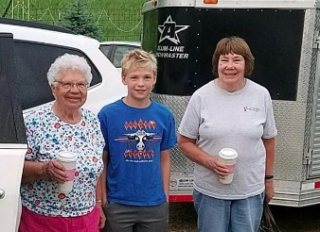
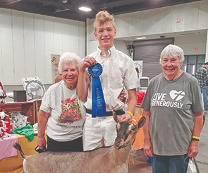
Other...
  Started with Goats - her neighbors, Leif & Bertha Jorgensen had goats!
  Minnesota Mentors – Linda Libra and Marjorie Kitchen
  Retired to SE Minnesota with housemate Marge & some neighbors up the hill, the Thompsons
  Currently “about” 40 goats
  Currently mentoring 3 nearby herds & other youth over the years

Slide 5
The Oberhaslis Story
  Karyl encouraged Linda Libra to learn AI in the 80’s
  They purchased a semen tank together
  They visited Dorothea Custer’s Seneca Valley Obers
  On the 2nd visit in 1985, Karyl bought 2 doe kids
  One was AI’d by Linda to Lyme Kiln Hans Michael
  Karyl named the resulting doe kid Cherry Pie
  The rest is history

Slide 6
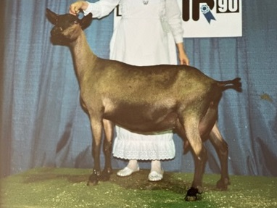
National Shows – Cherry Pie
(w/ Ice Cream on Top)
SGCH Body Shops 21 Cherry Pie in 1990
Her 2nd of 5 Consecutive National Championships

Slide 7
SGCH Body Shops 21 Cherry Pie
National Show Grand Champion Oberhasli
  1989 – Oklahoma City, OK - Peggy Considine
  1990 – Pomona, CA – Sue Barker
  1991 – Gillette, WY – Jeff Klein
  1992 – Amarillo, TX – Steve Richter
  1993 – Harrisburg, PA – Joan Dean Rowe

Slide 8
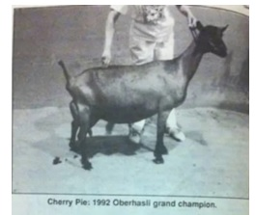
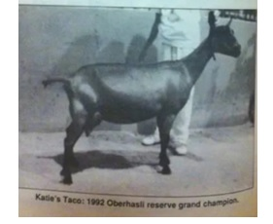
Not Just One Pretty Face
Cherry Pie – 1992
Body Shops F Katie’s Taco
Rs. Nat’l Champion – 1991 & 1992

Slide 9
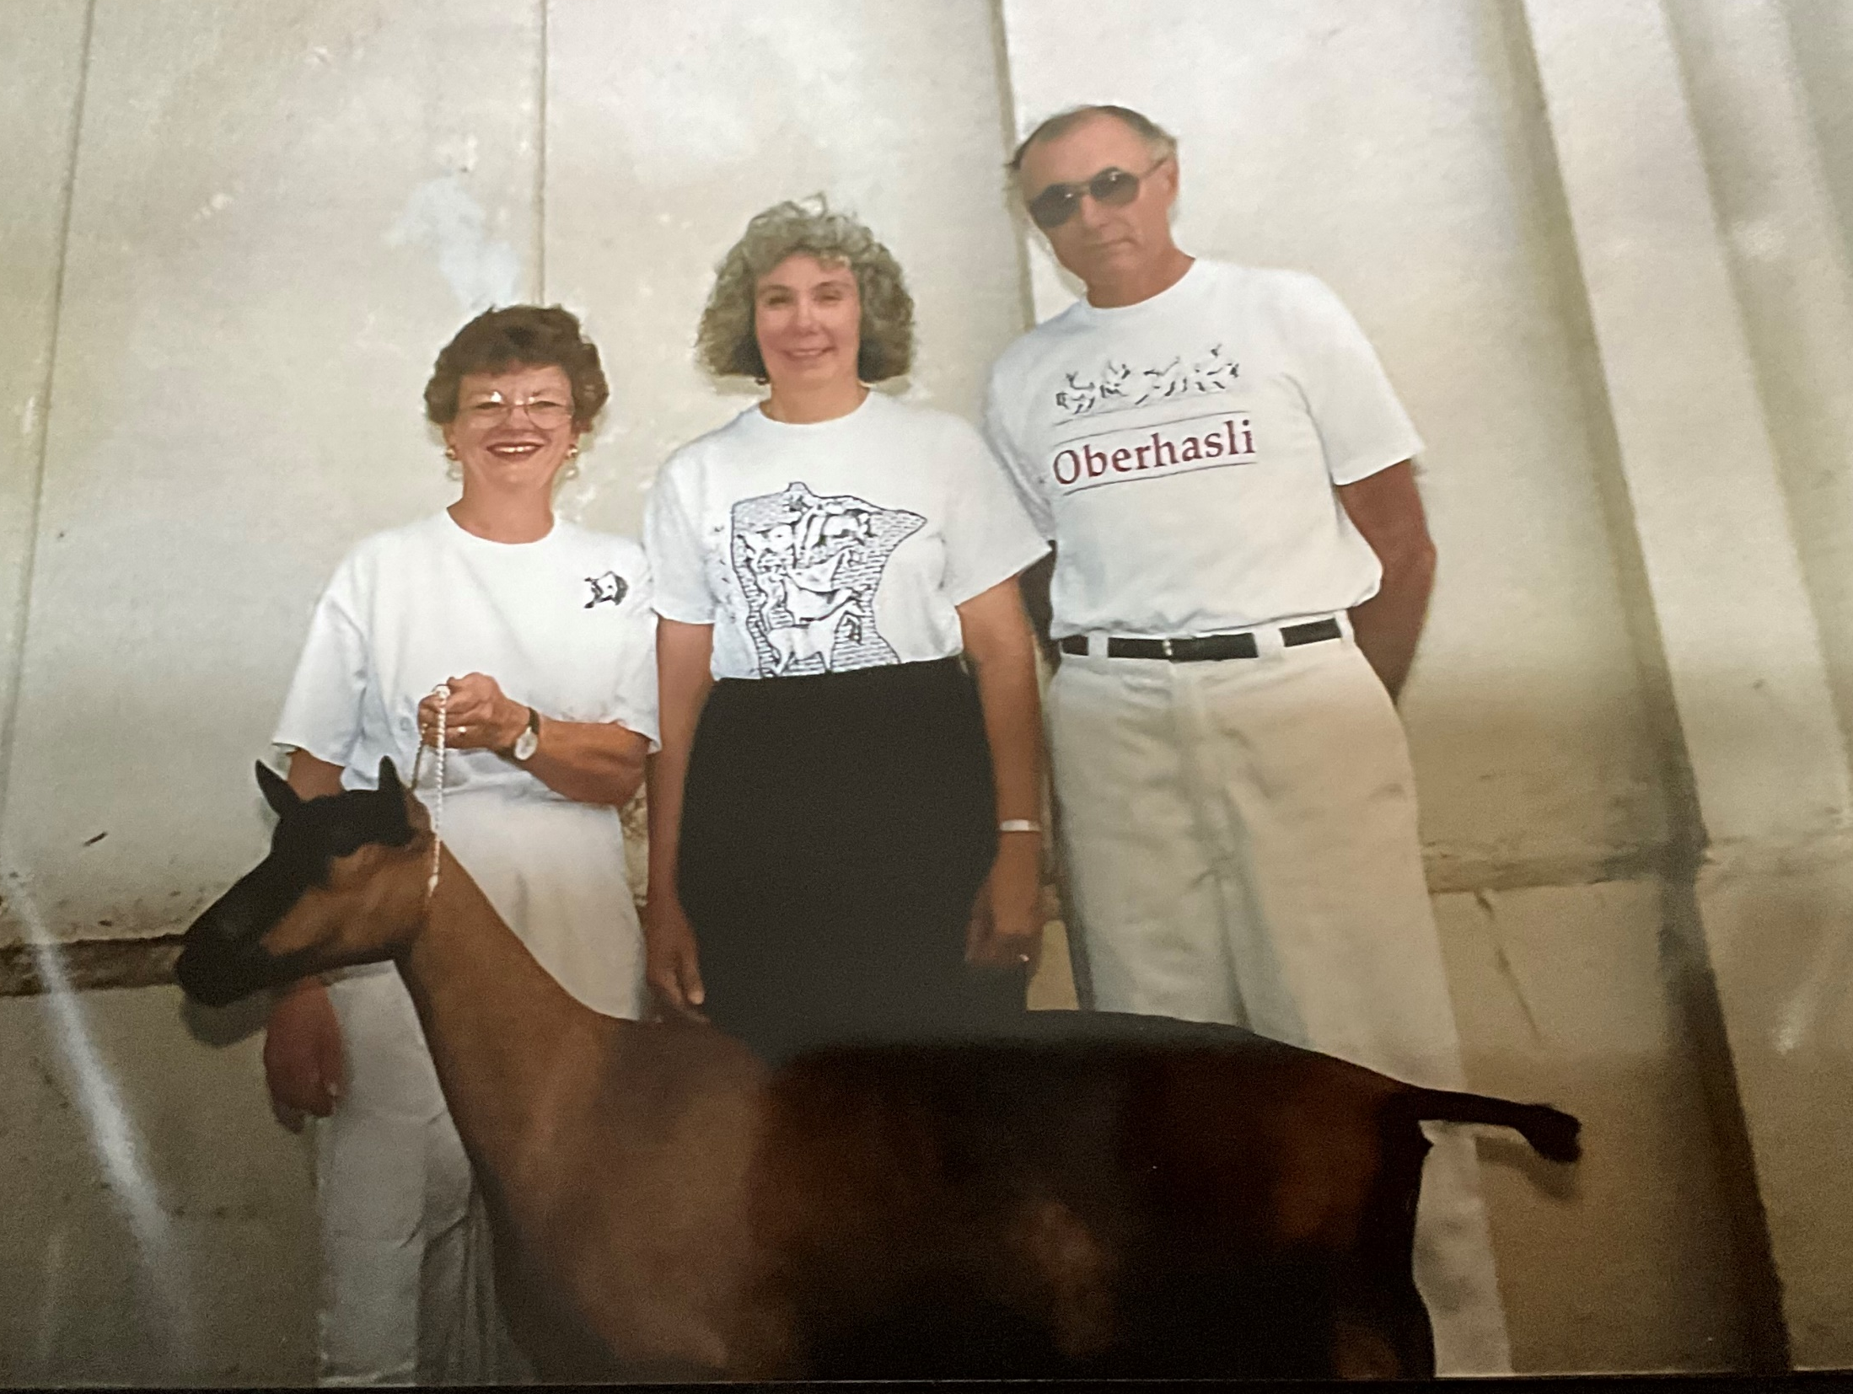
Fellow Minnesota Oberhasli Breeders with a deep Body Shops foundation
Peggy and Dave Daubert of the Tonka Tails Herd in Minnesota

Slide 10
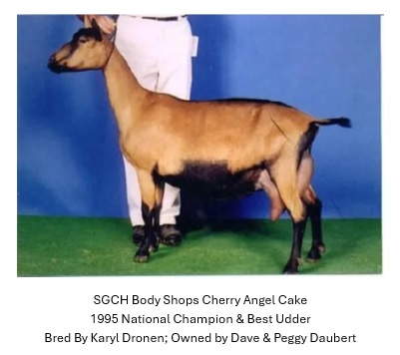
Next Up...Body Shops Cherry Angel Cake

Slide 11
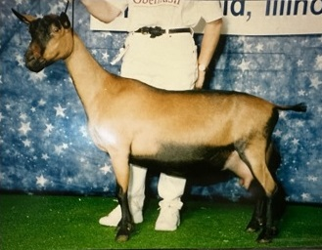
The Saga continues...
SGCH Tonka Tails Parson’s Divinity
At Karyl’s suggestion, the Dauberts bred Cherry Angel Cake to Body Shops Tipsy Cherry Parson
Resulting in Divinity, 3X National Champion-1996, 1997 & 1998

Slide 12
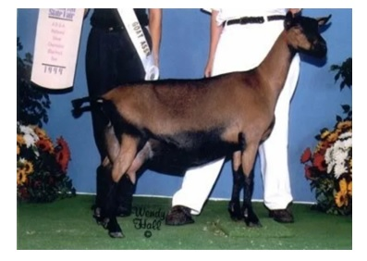
The String Continues...
SGCH Body Shops Blueberry Dumpling,
a half-sister to Cherry Angel Cake
1998 Rs. National Champion & 1999 National Champion

Slide 13
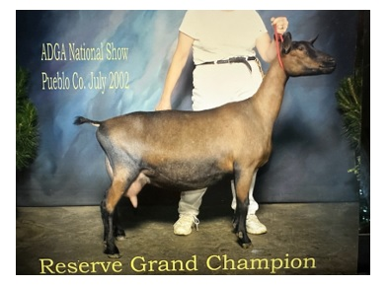
And on we go....
Blueberry Dumpling’s Daughter, SGCH Tonka Tails Kendall Rae
2000 Rs. Nat’l Champion, 2001 Nat’l Champion, 2002 Rs. Nat’l Champion

Slide 14
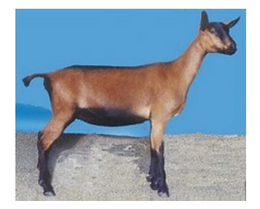
From There, Into the Future...
2000 Jr. Nat’l Champion, Body Shops PC Frangelico
Another Junior Doe, Body Shops SB Polenta was the 2001 Rs. National Champion
Polenta - a prolific brood doe for the Brackett’s Sunburst herd and in the pedigree of 2018 Nat’l Champion, SGCH Haycreek’s Kane’s Stradivaria

Slide 15
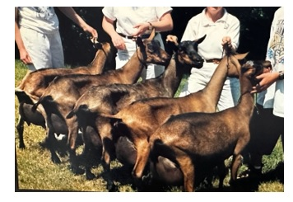
As for Groups, You Could Mix and Match Many Ways
Cherry Pie, Taco, Cherry Angel Cake, Divinity, &
GCH Seneca Valley’s Adolpha

Slide 16
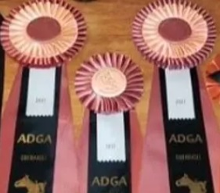
A Remarkable Record of National Show
Grand Champions, Reserves, or Premier Sires
From 1989 through 2023, there was a Body Shops or Tonka Tails sire or dam in the pedigree or close extended pedigree!

Slide 17
Karyl’s Committee Work
Products Committee...Just One ADGA Committee?
Yes, but 37 years from 1986 until 2022, Chair since 2005
Innovation - the presentation of cheeses and soaps at the National Convention evolved under Karyl’s leadership
“I worked many years...giving recognition to dairy goat producers through creations of competitions for both cheese and soap.”
There actually was one other committee – Chair of AGS Breeds Cmte

Slide 18
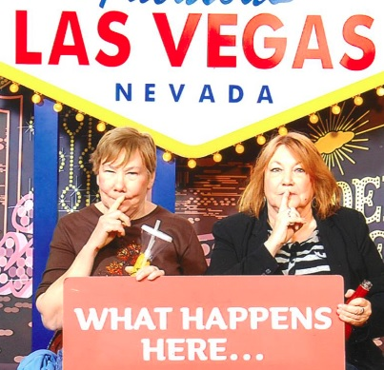
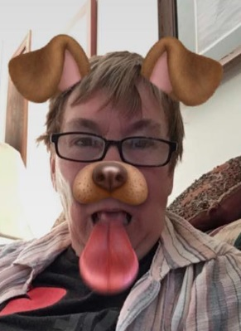
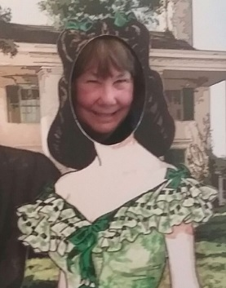
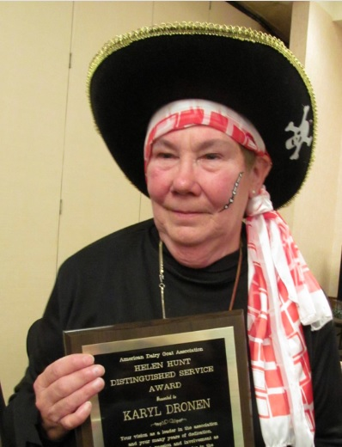
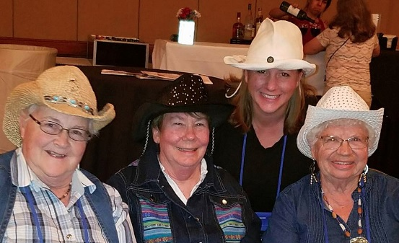
Always Time for a Little Fun Along the Way

Slide 19
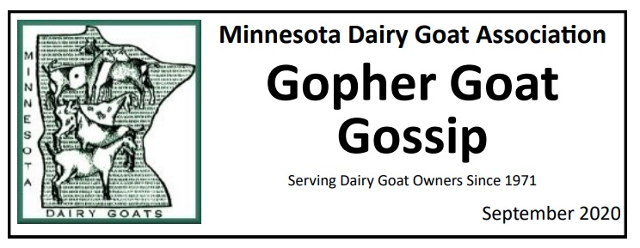
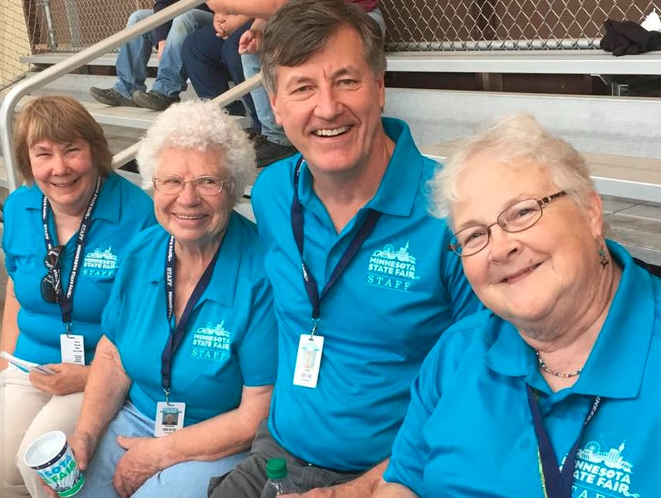
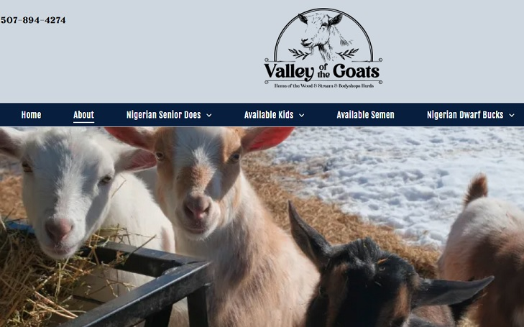
And There’s More

Slide 20
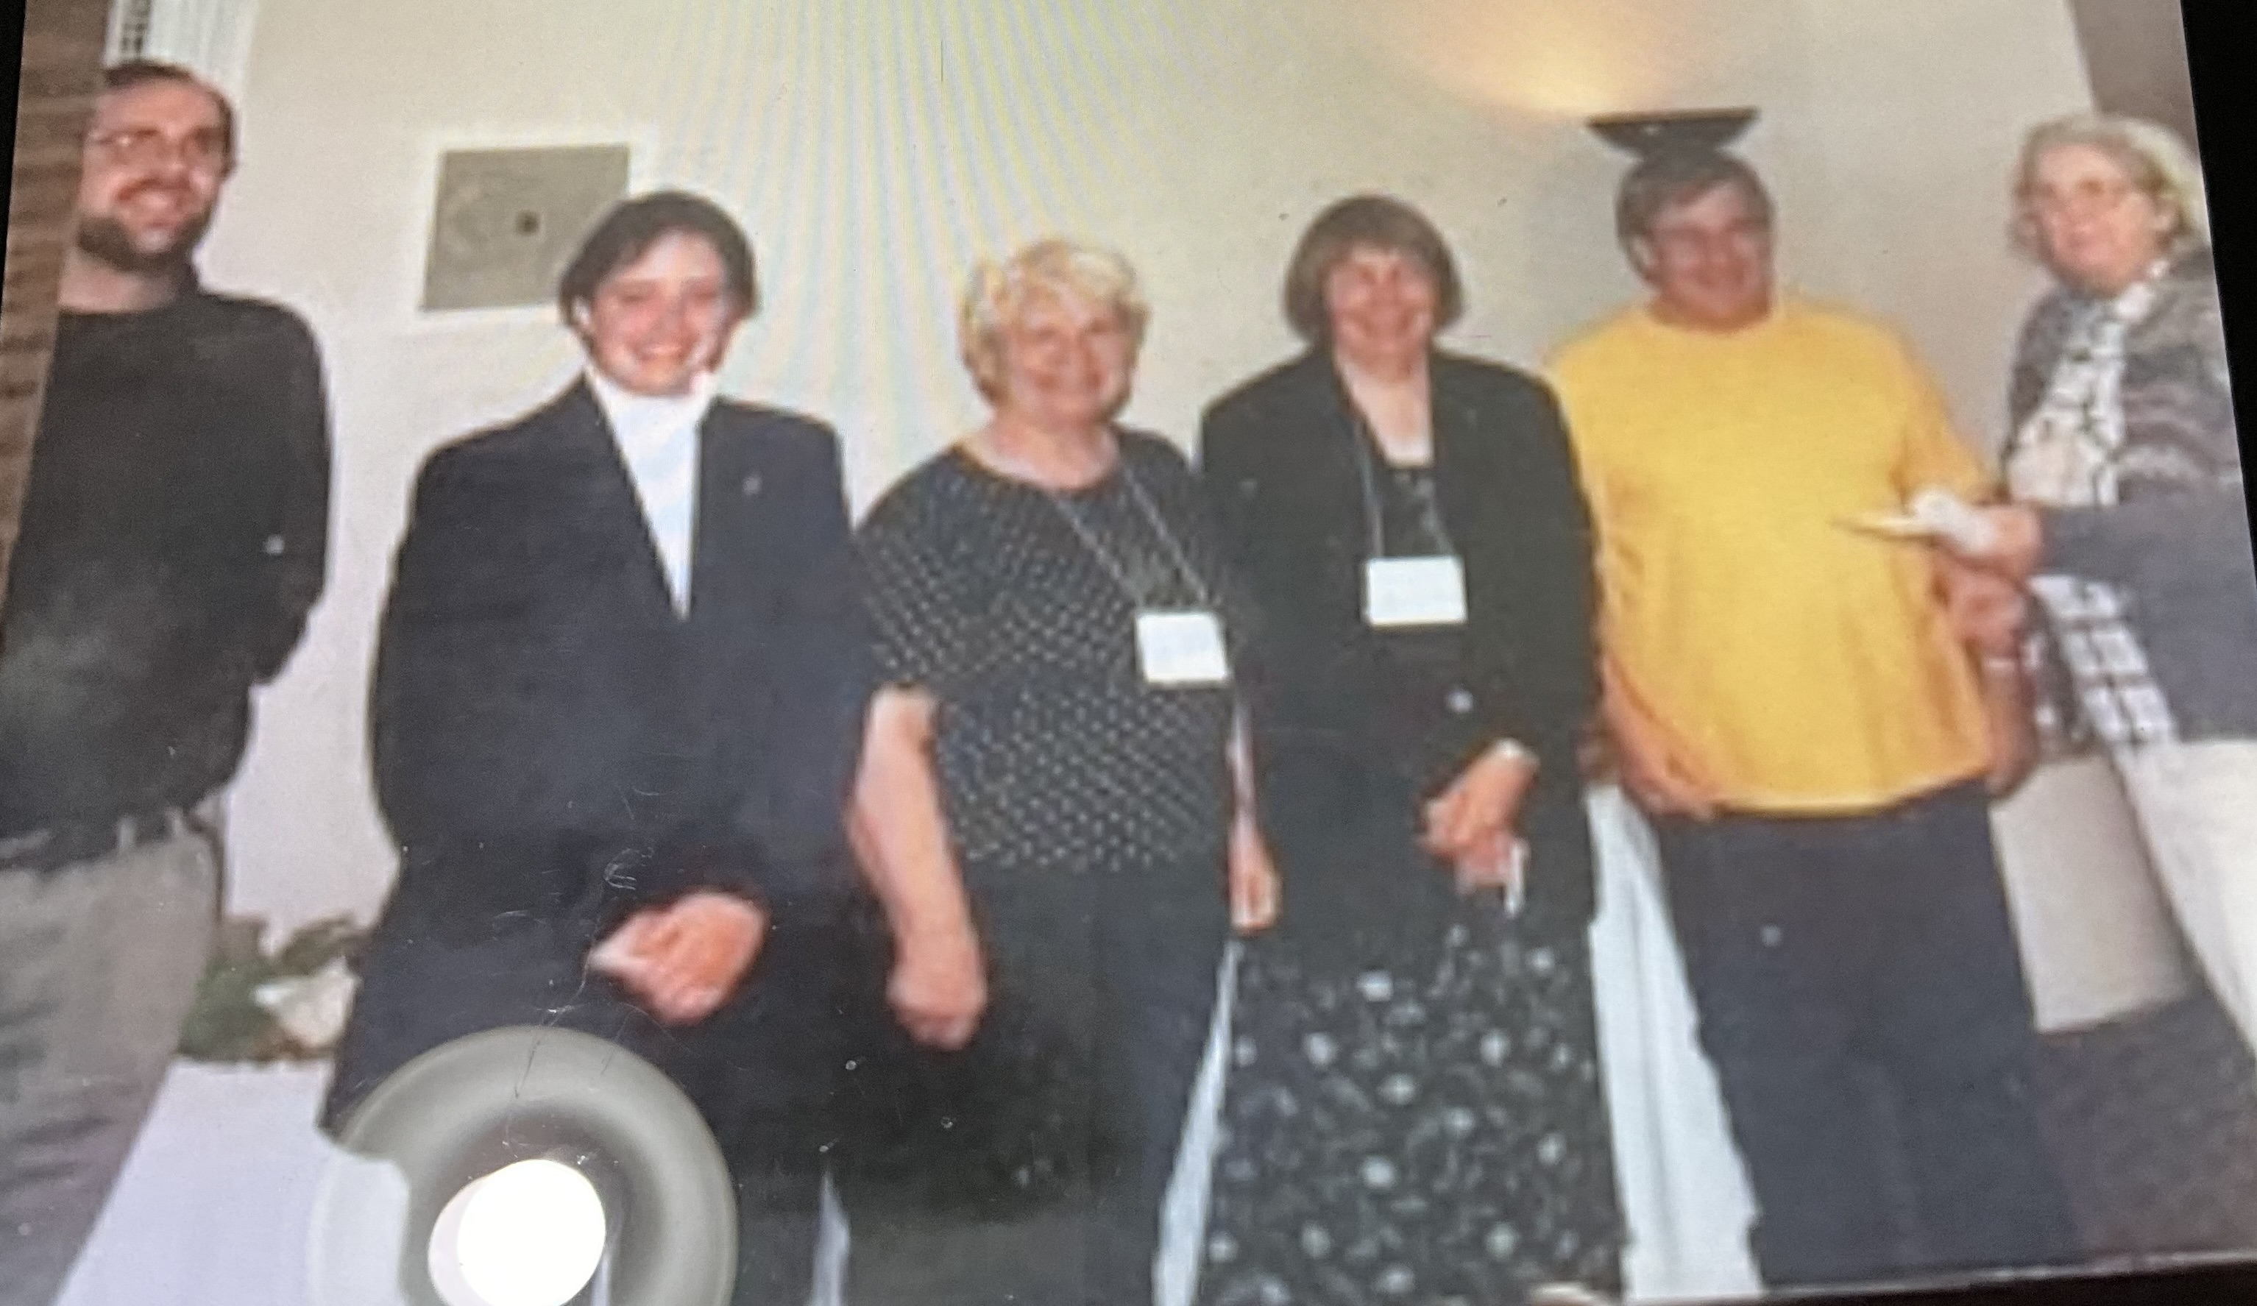
Greatest Accomplishment in Dairy Goats...
“Promoting the Acceptance of the Nigerian Dwarf Breed in ADGA.”
  All of us on the committee worked for years to get Board members
  to see the value of this breed to the survival of ADGA
Tom Rucker, Andrea Forest, Marge Kitchen, Karyl Dronen, Allen Cunningham, Elaine Considine
(Picture by Harvey Considine, following the acceptance of the breed by the ADGA BOD, 2005)

Slide 21
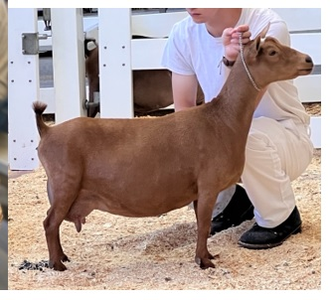
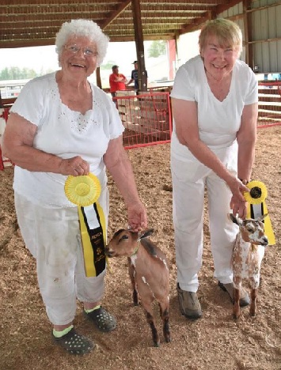
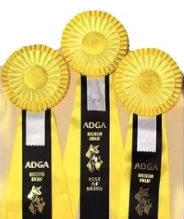
In 2010, Karyl exhibited Nigerian Dwarf in their
1st year of competition at the National Show,
alongside her partners, Earl and Marjorie Kitchen
Remaining Goal...
“Breeding Nigerian Dwarf goats that reach the quality of other herds in the breed.”
Body-Shops IB Sunflower...Appraised 91 in 2024 at four years of age

Slide 22
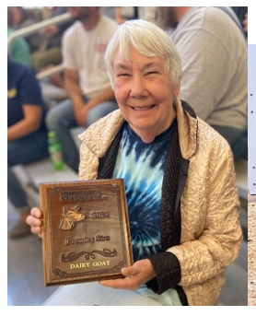
Karyl Dronen – ADGA Pioneer
Plans for the Future?
“Working for ADGA wherever needed.”

